Slide 1
Contrafact Detection Analysis – Rank One Results
26-July-2022

Slide 2
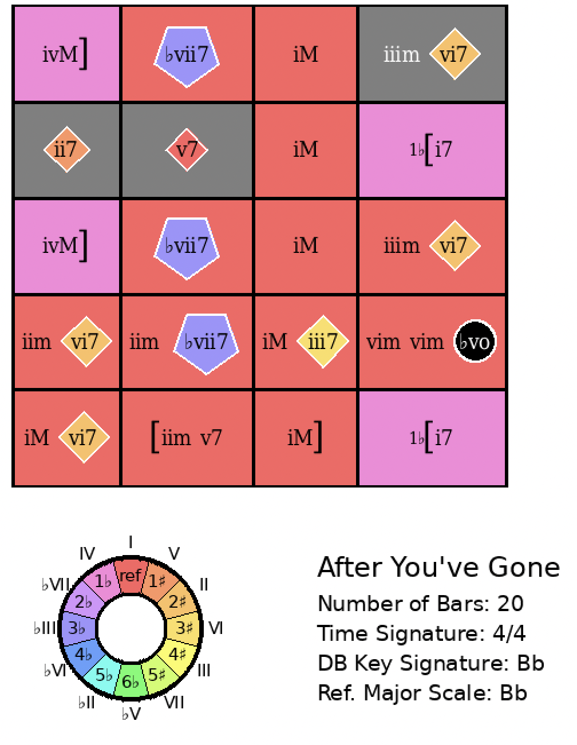
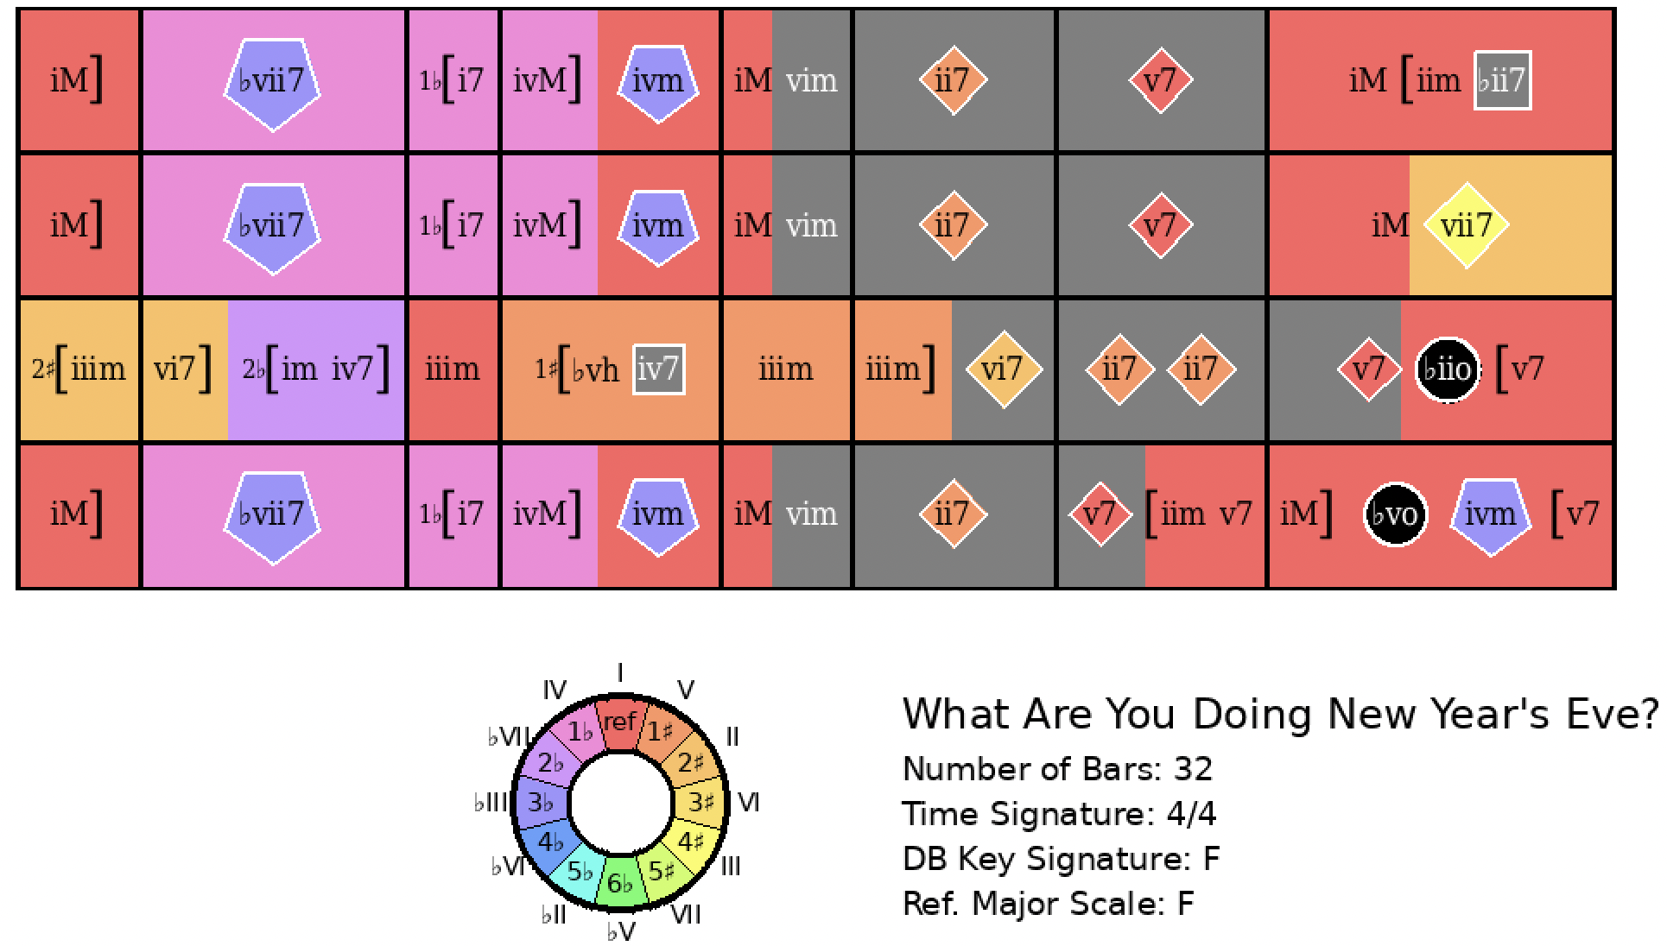
After You’ve Gone
Rank = 1, Area = 13.66

Slide 3
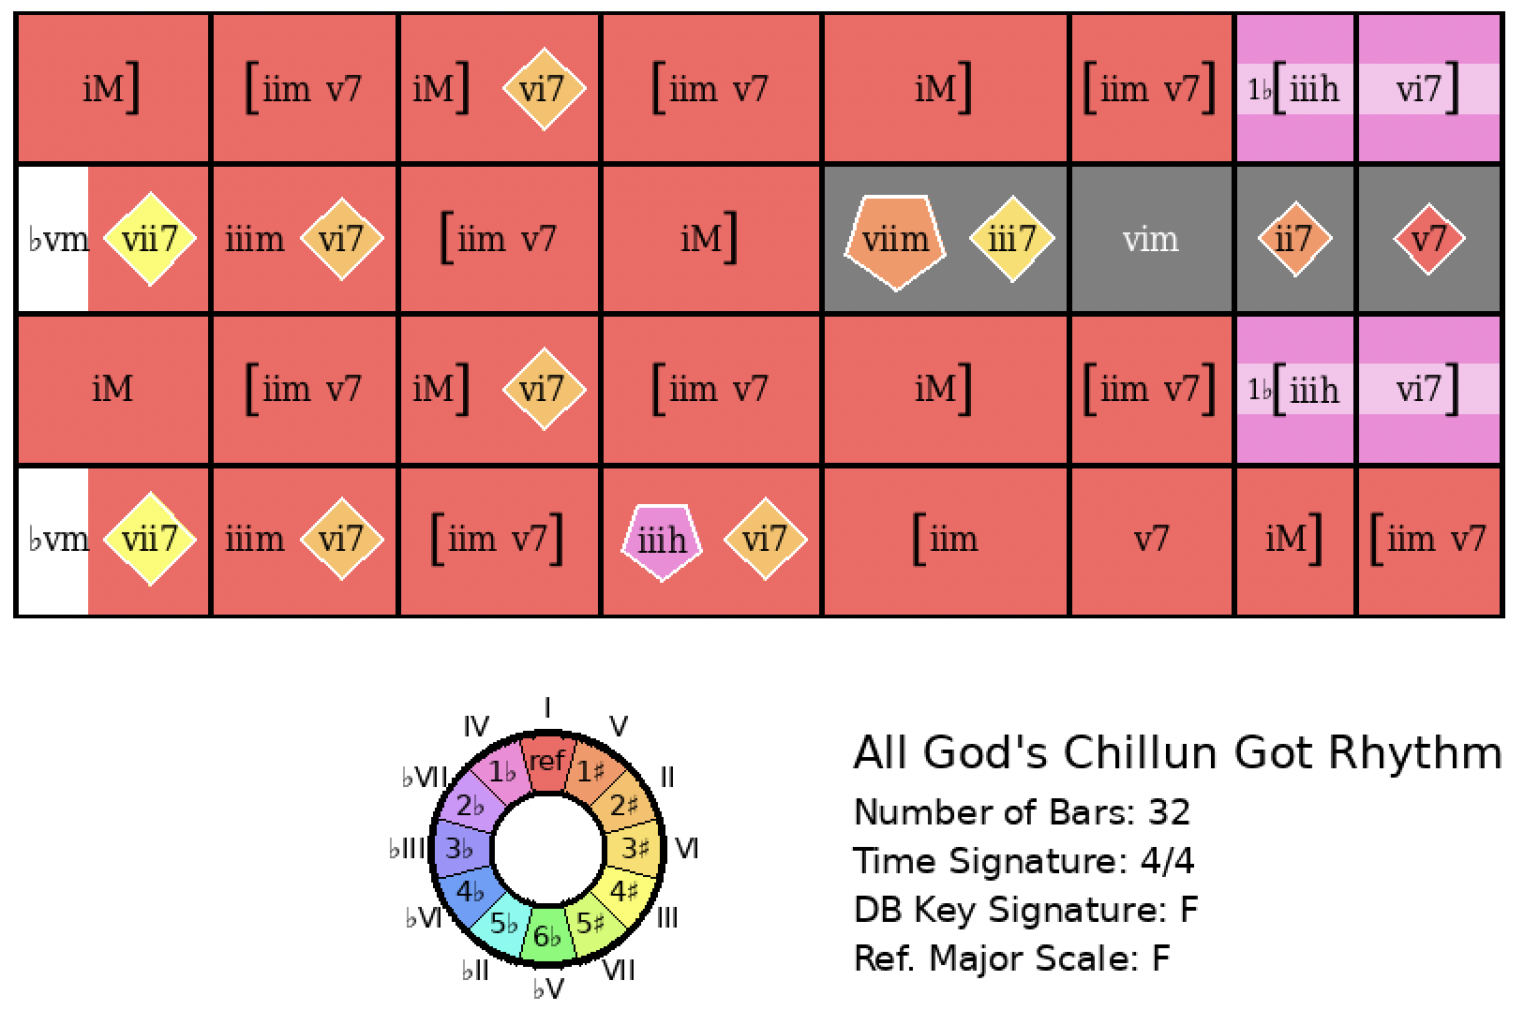
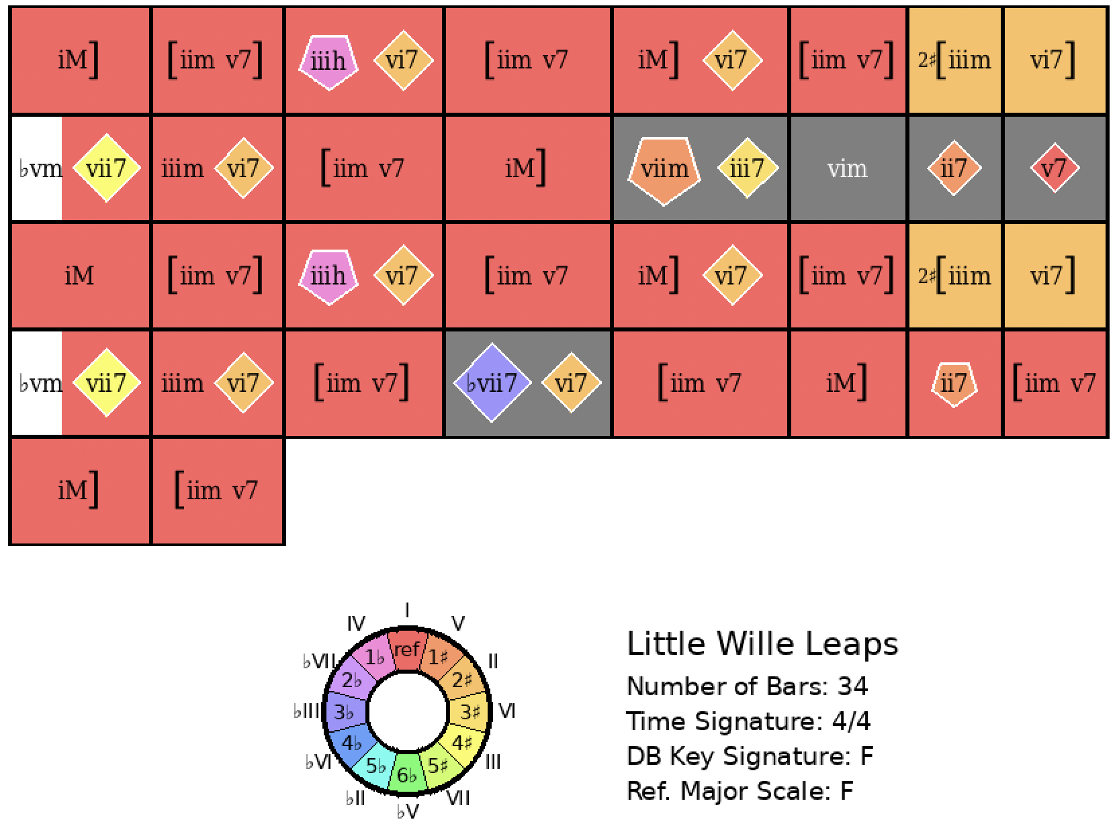
All God’s Chillun Have Rhythm
Rank = 1, Area = 12.55

Slide 4
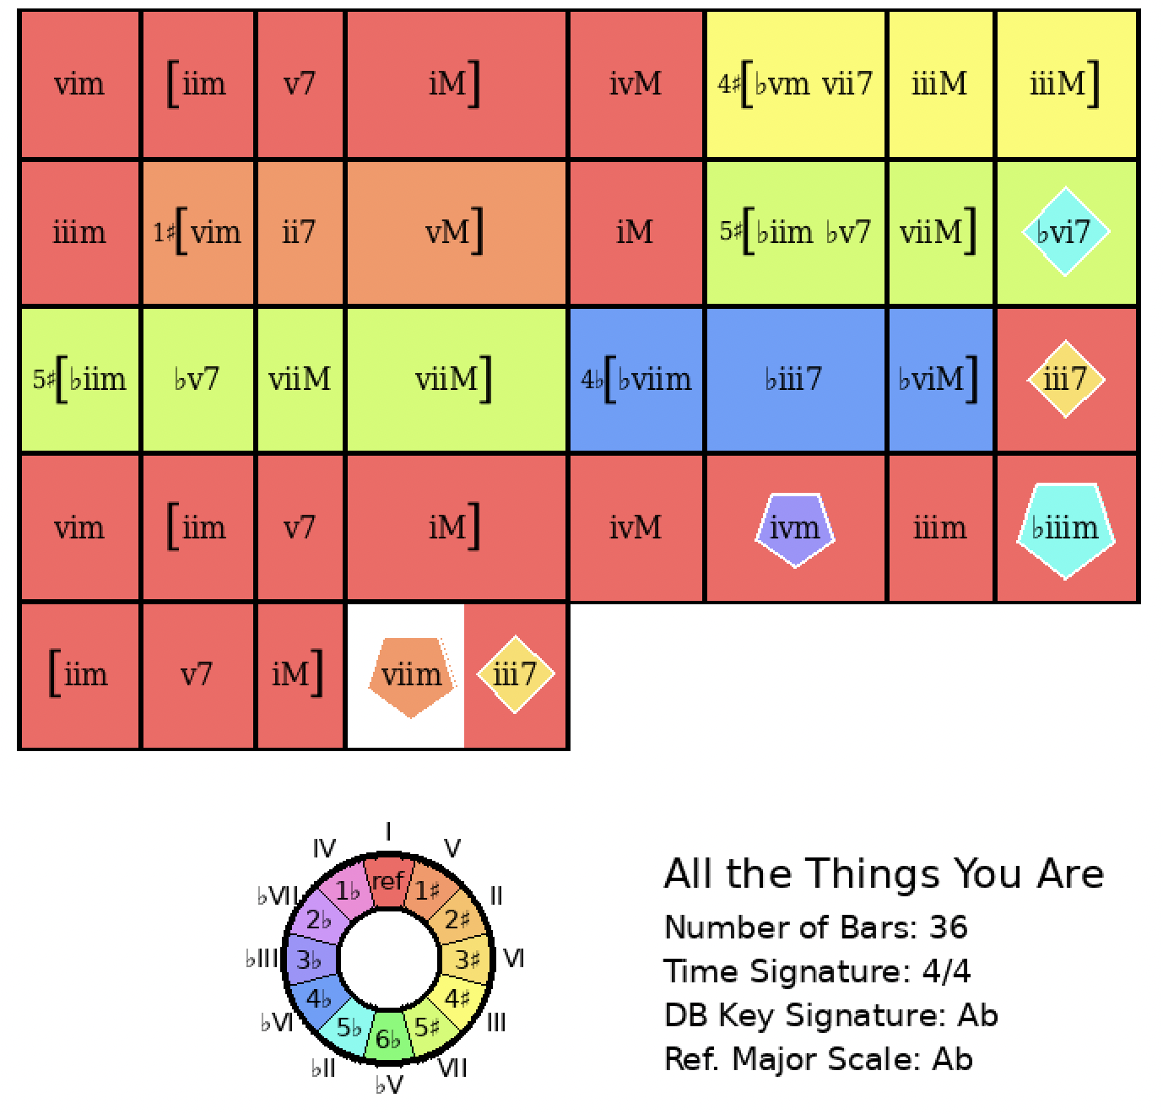
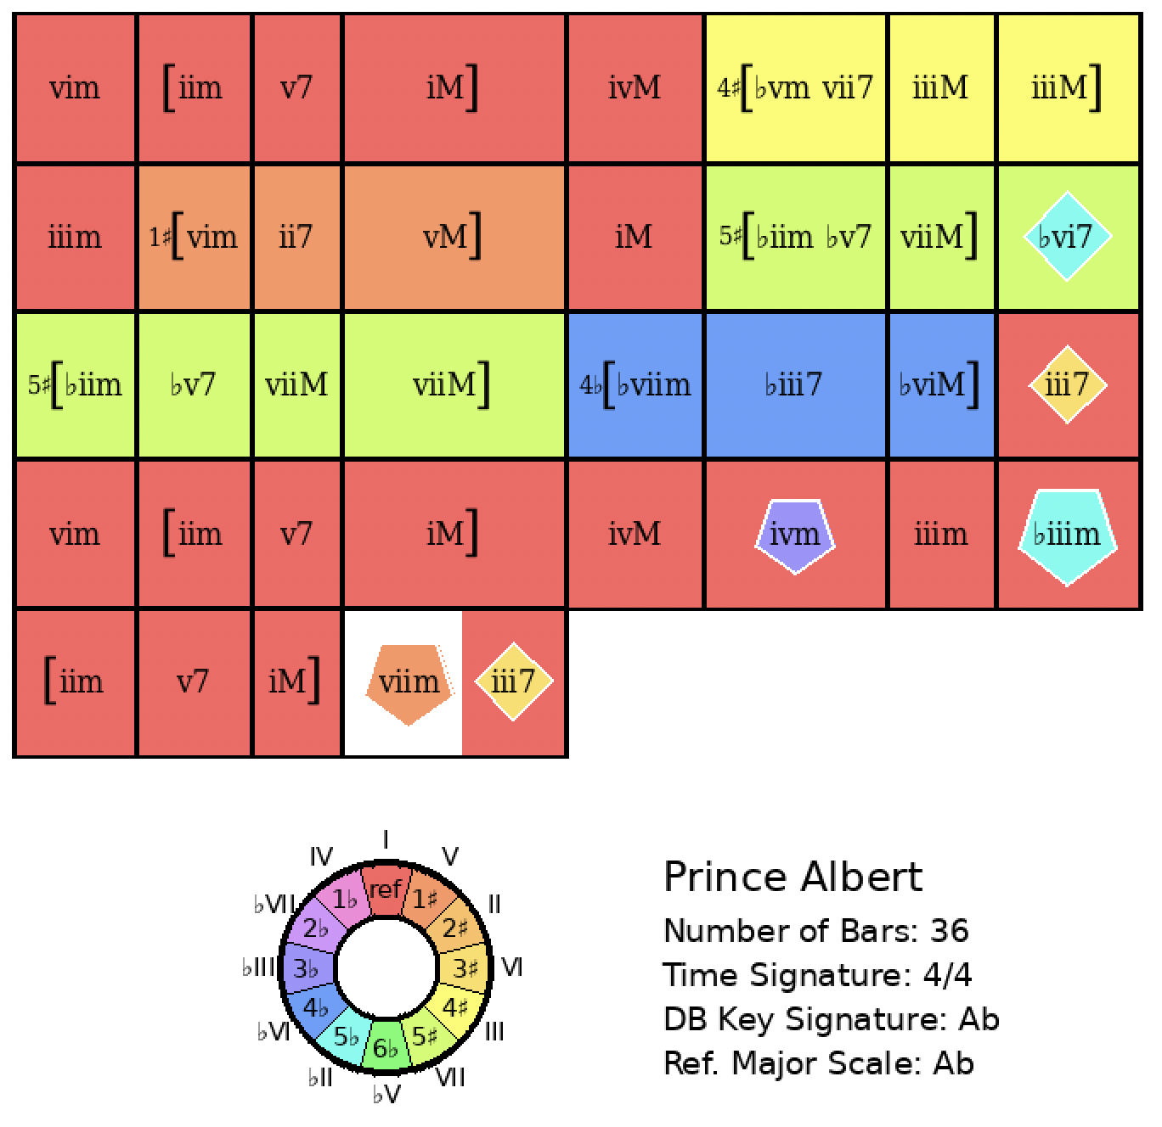
All the Things You Are
Rank = 1, Area = 0.00

Slide 5
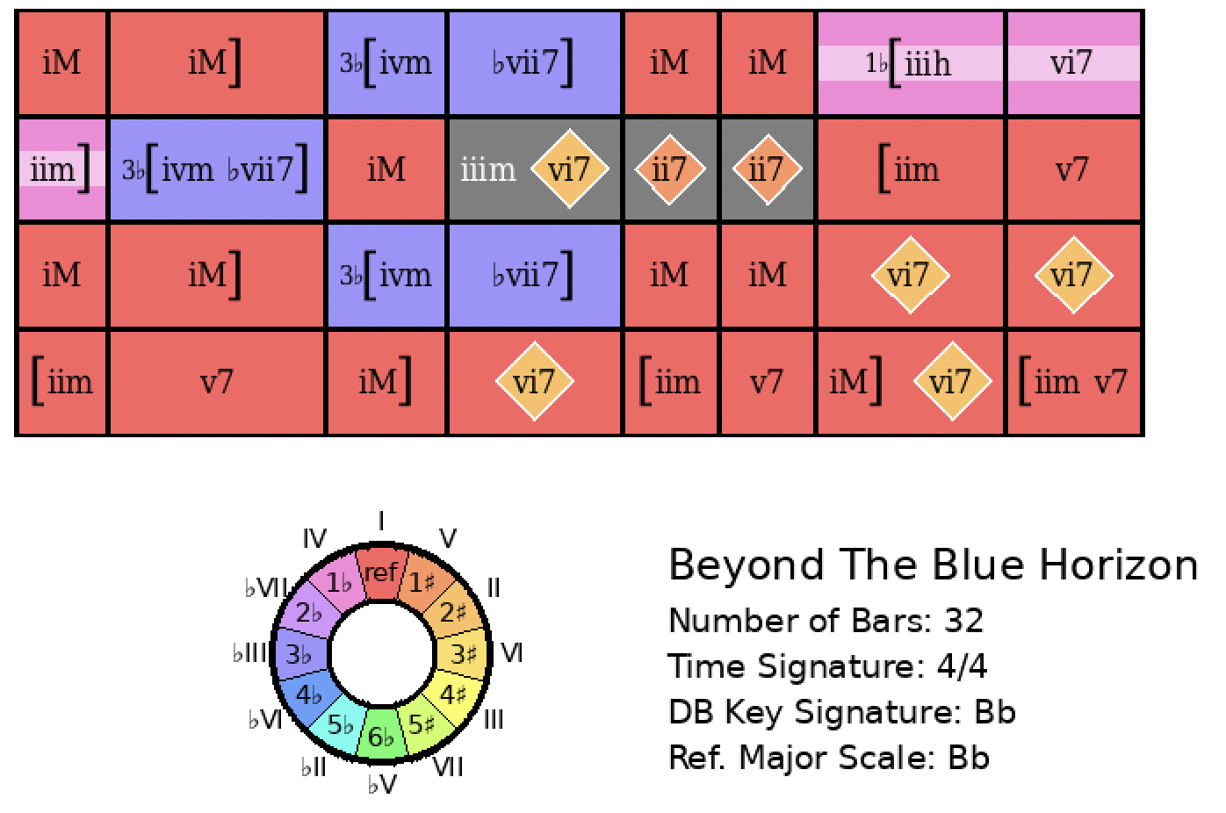
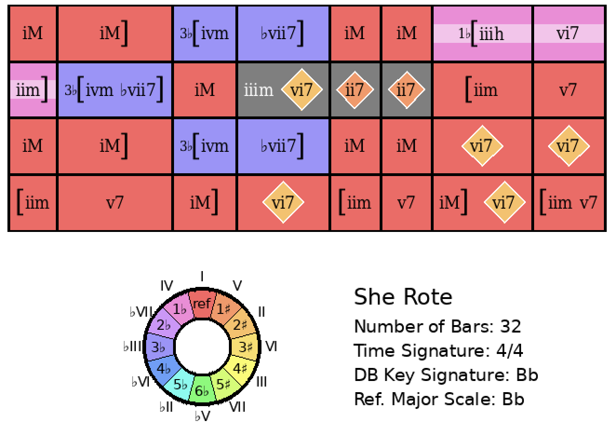
Beyond the Blue Horizon
Rank = 1, Area = 0.00

Slide 6
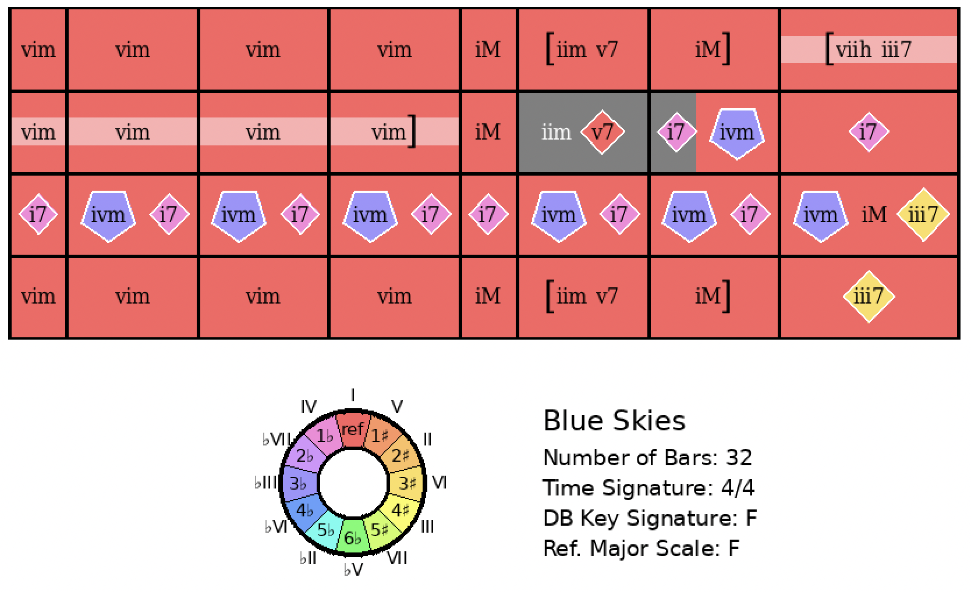
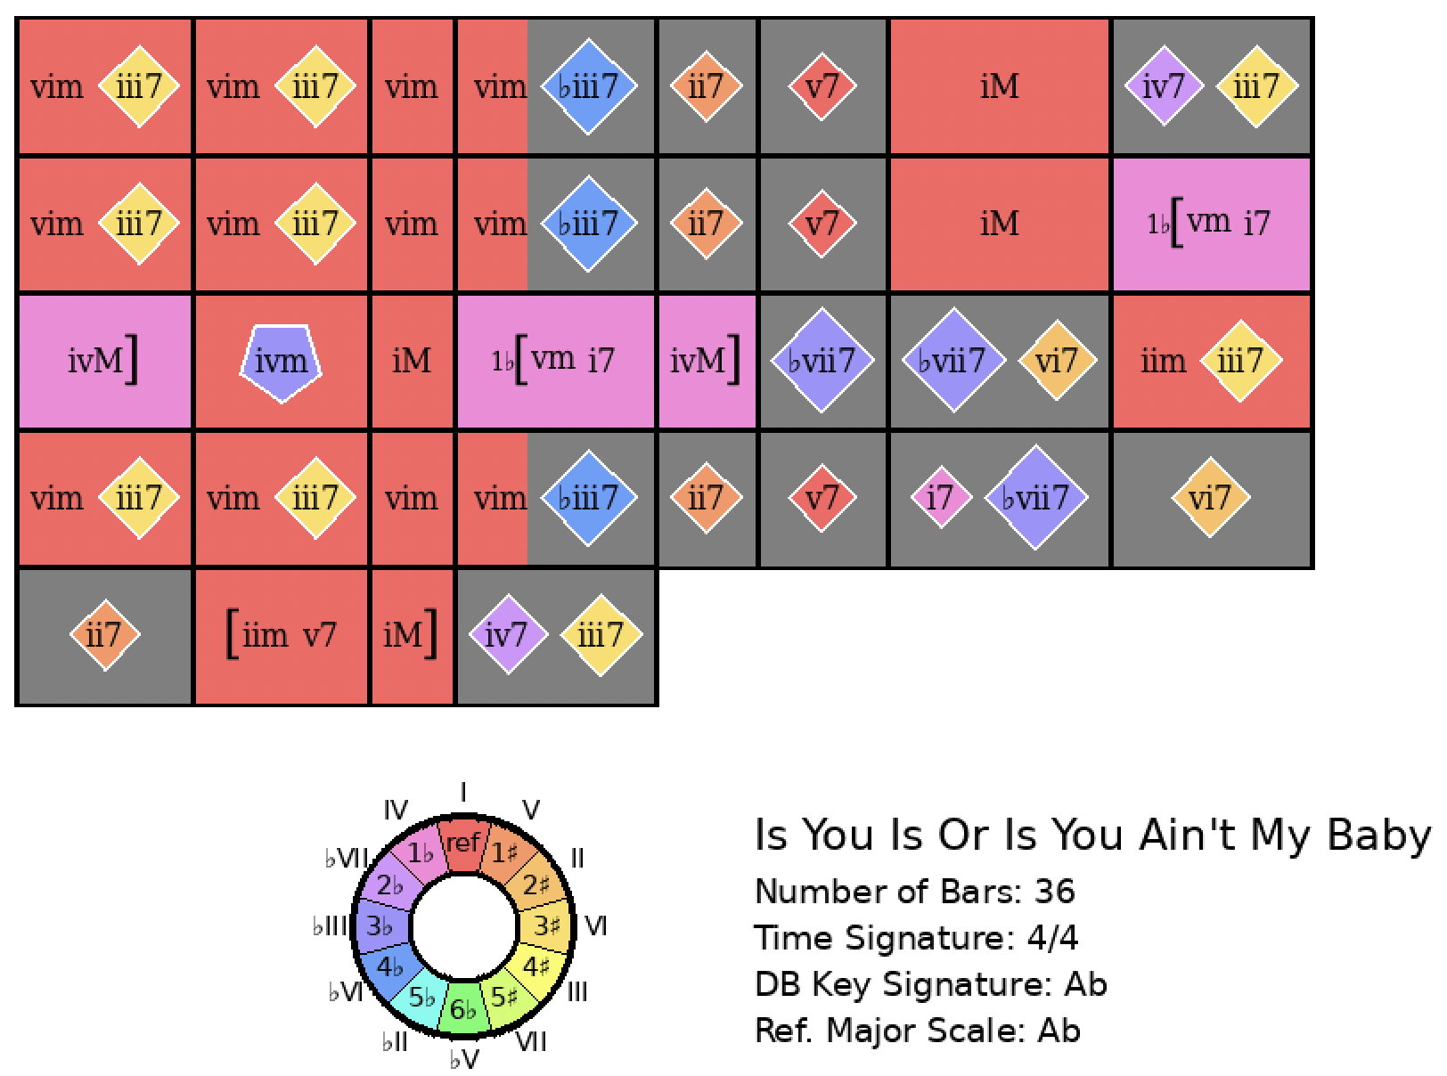
Blue Skies
Rank = 1, Area = 17.94

Slide 7
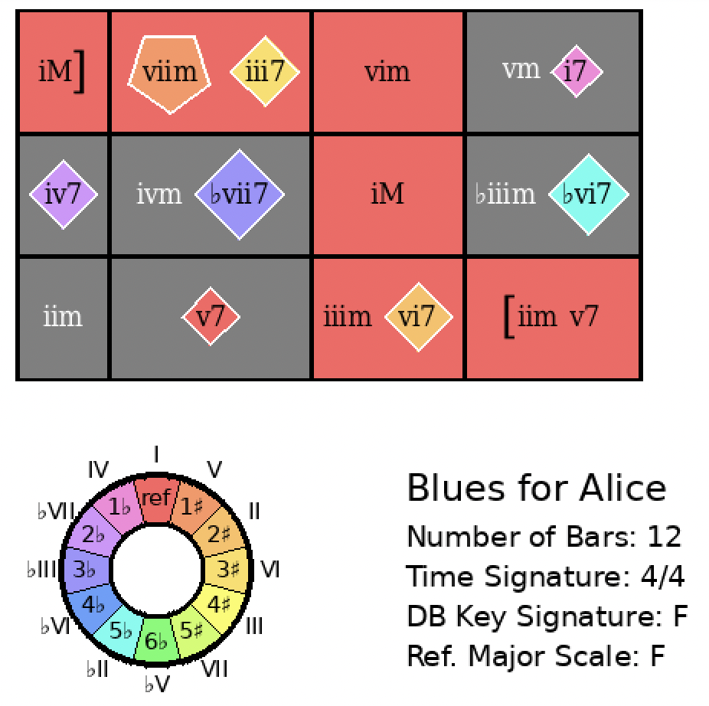
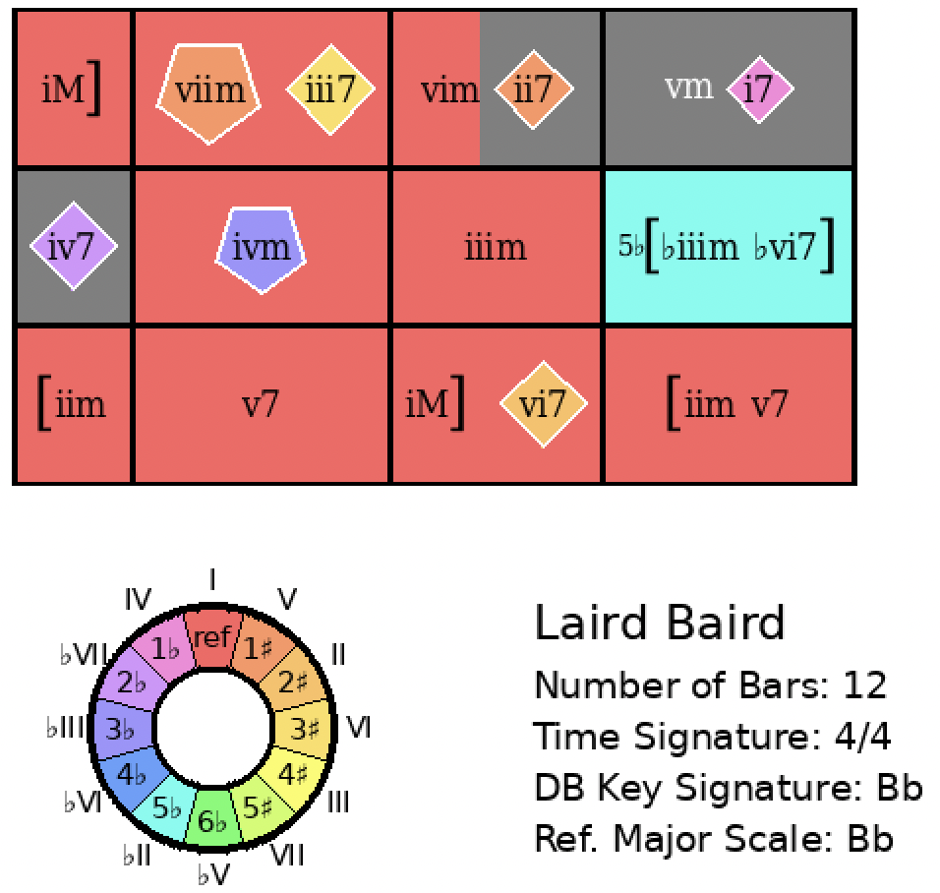
Blues for Alice
Rank = 1, Area = 11.16

Slide 8
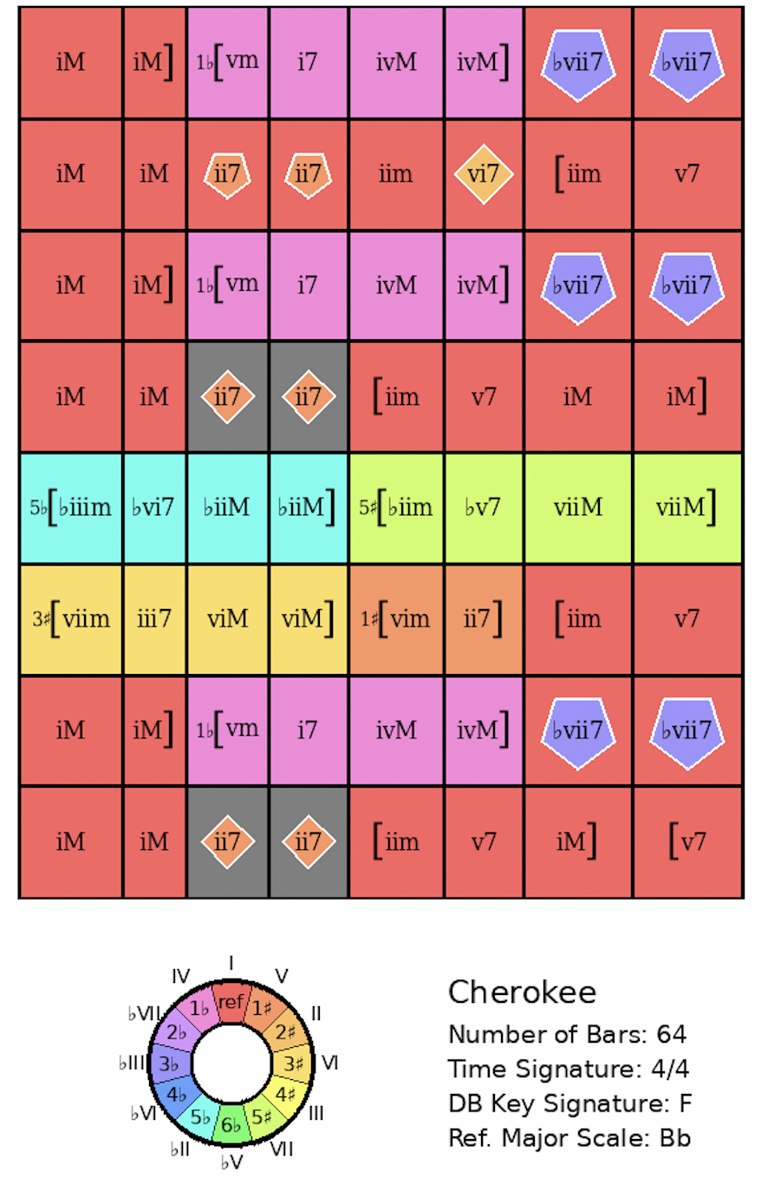
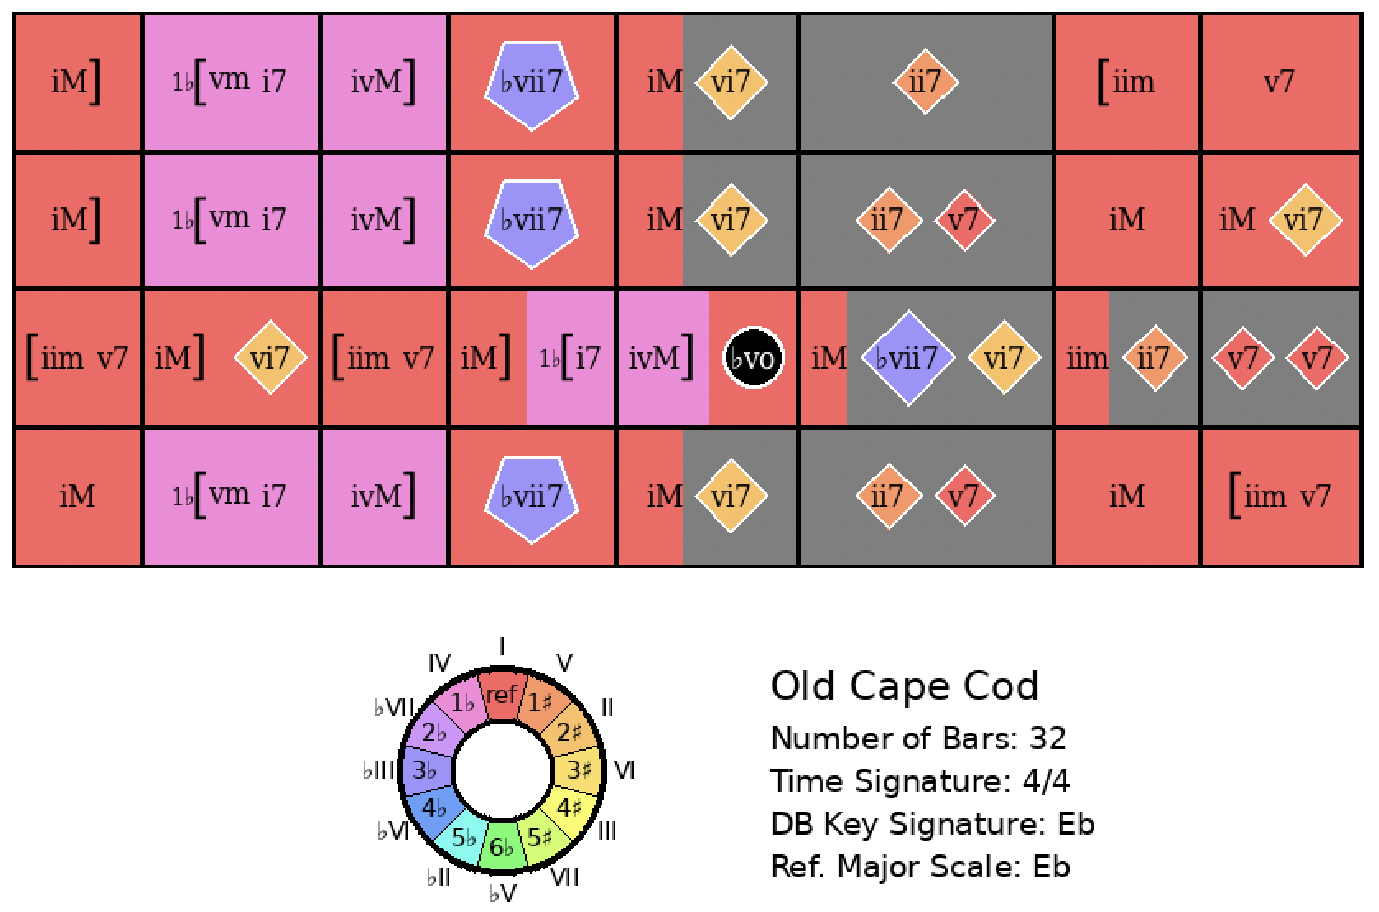
Cherokee
Rank = 1, Area = 13.71

Slide 9
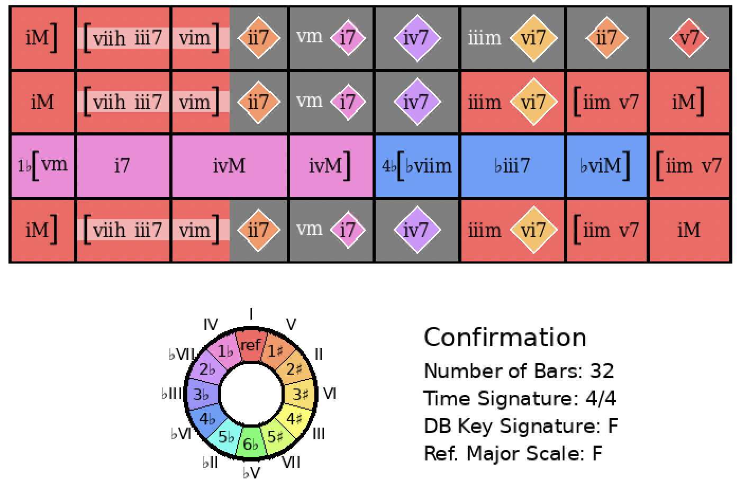
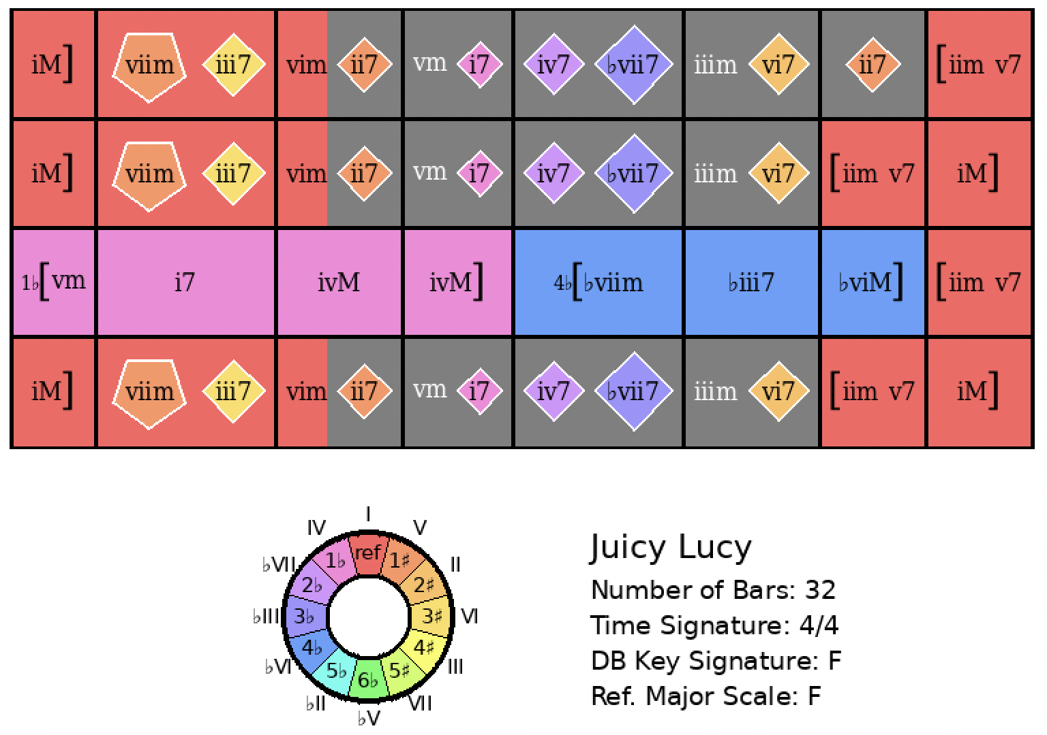
Confirmation
Rank = 1, Area = 7.38

Slide 10
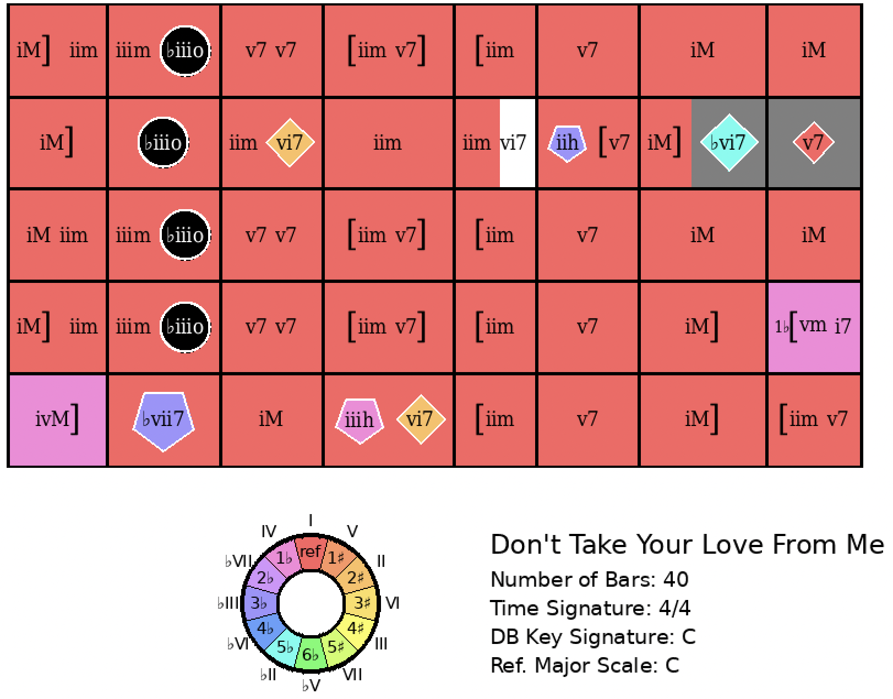
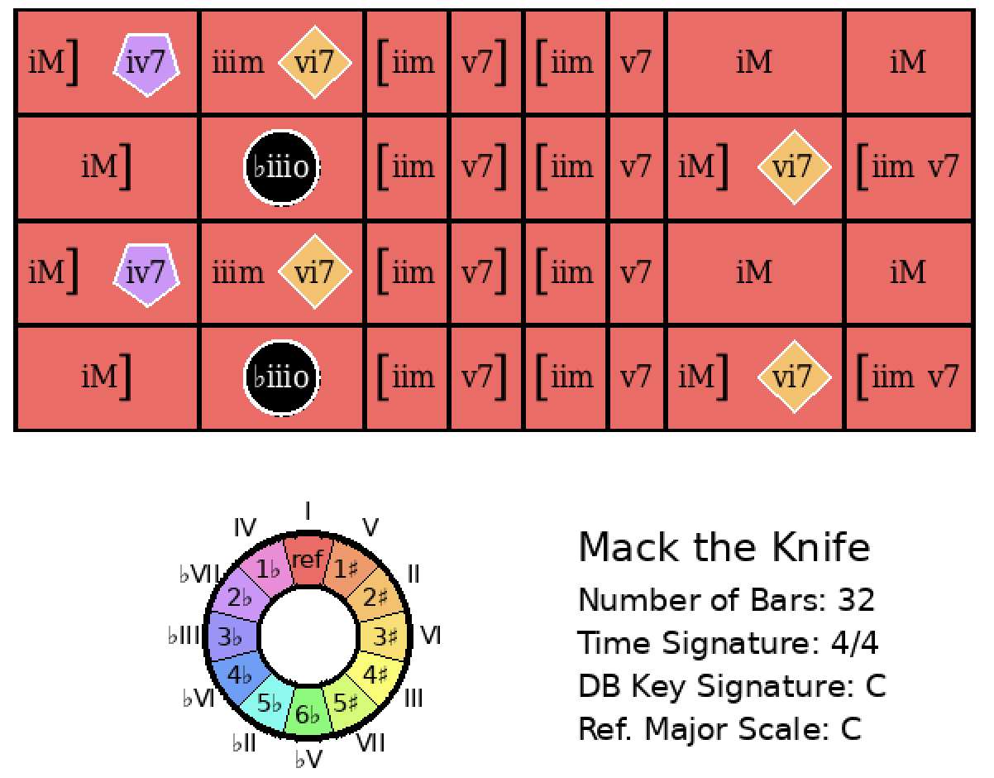
Don’t Take Your Love From Me
Rank = 1, Area = 8.04

Slide 11
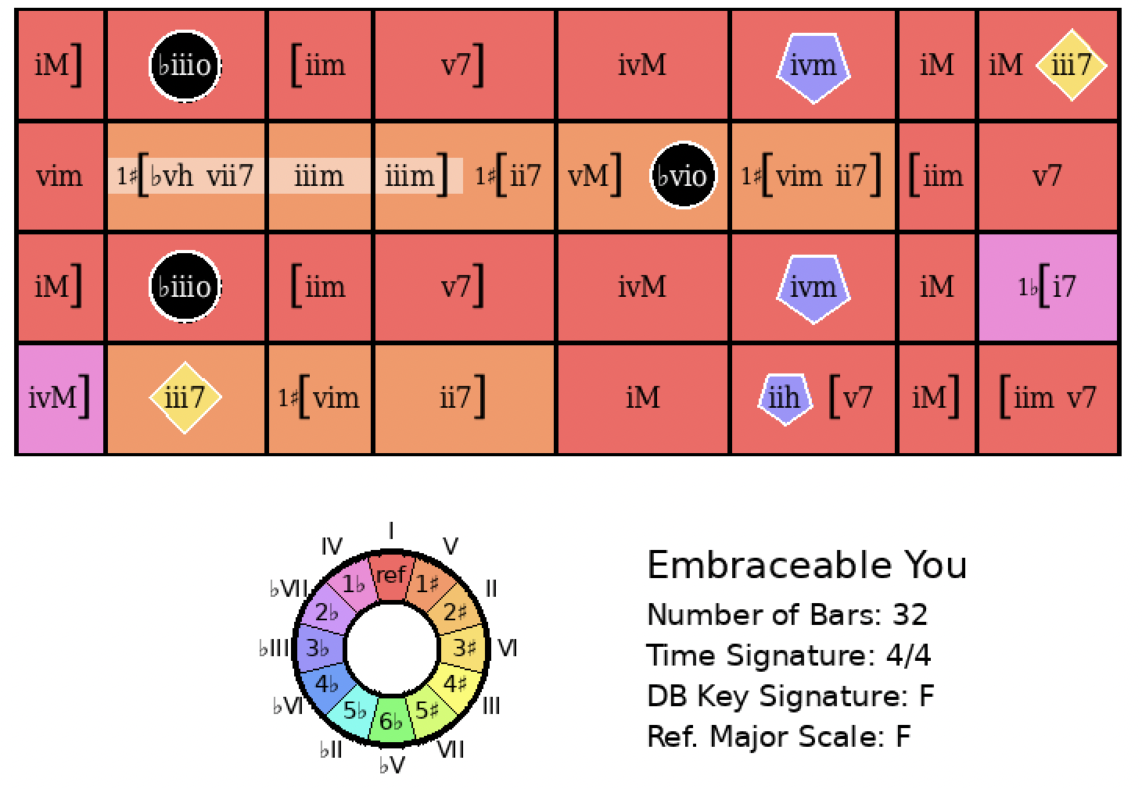
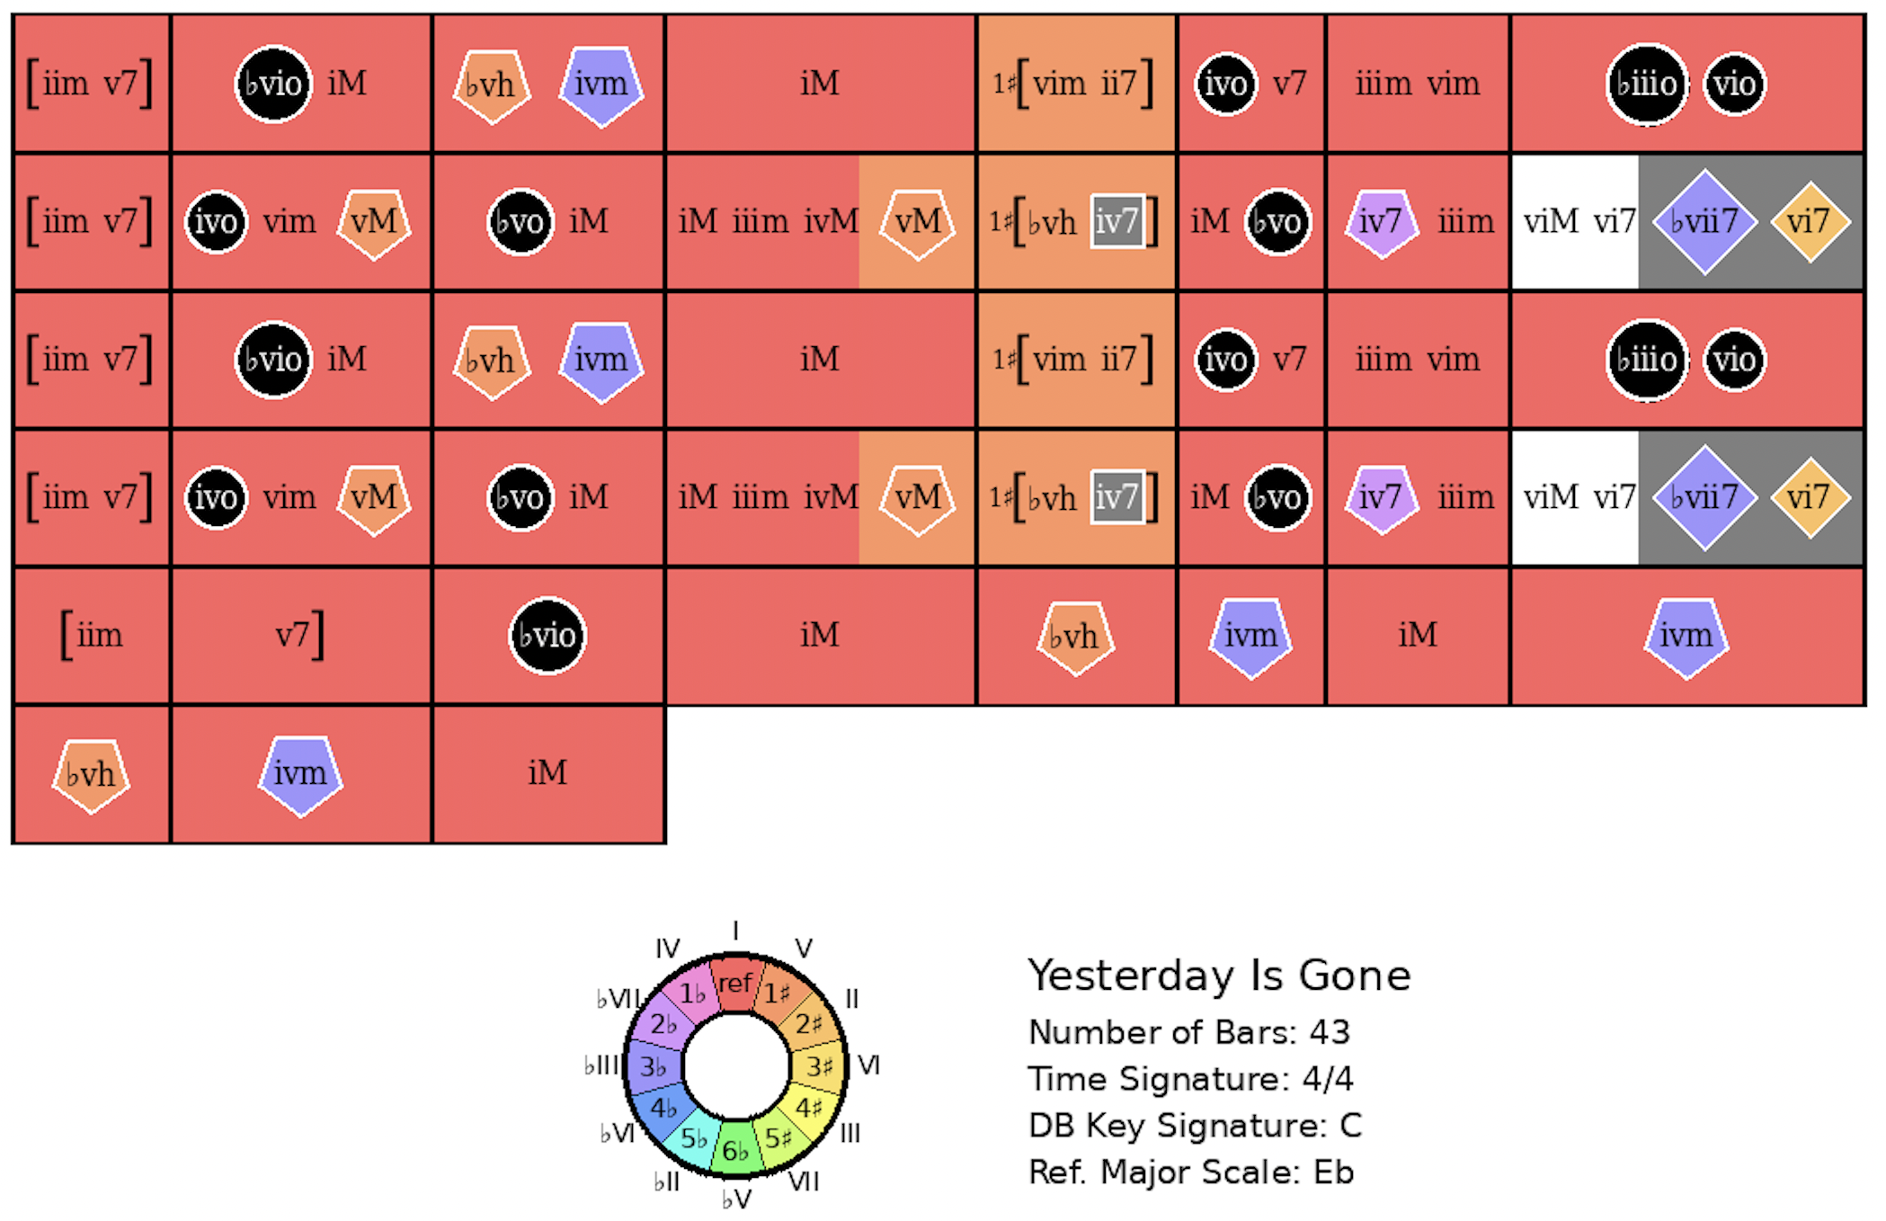
Embraceable You
Rank = 1, Area = 13.88

Slide 12
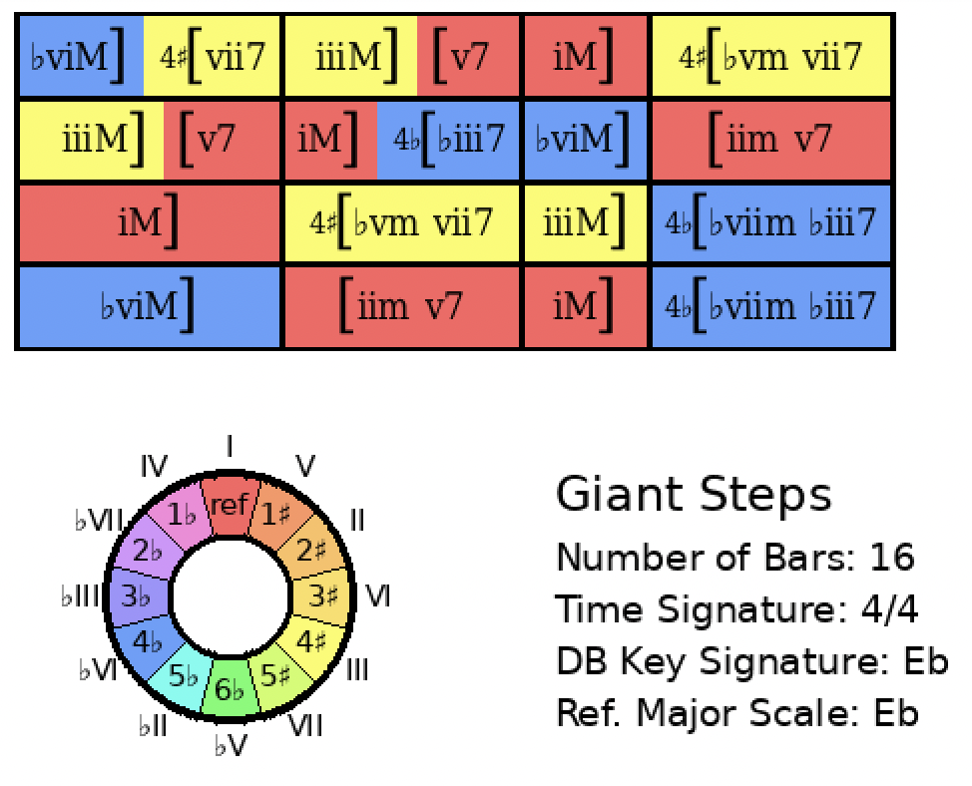
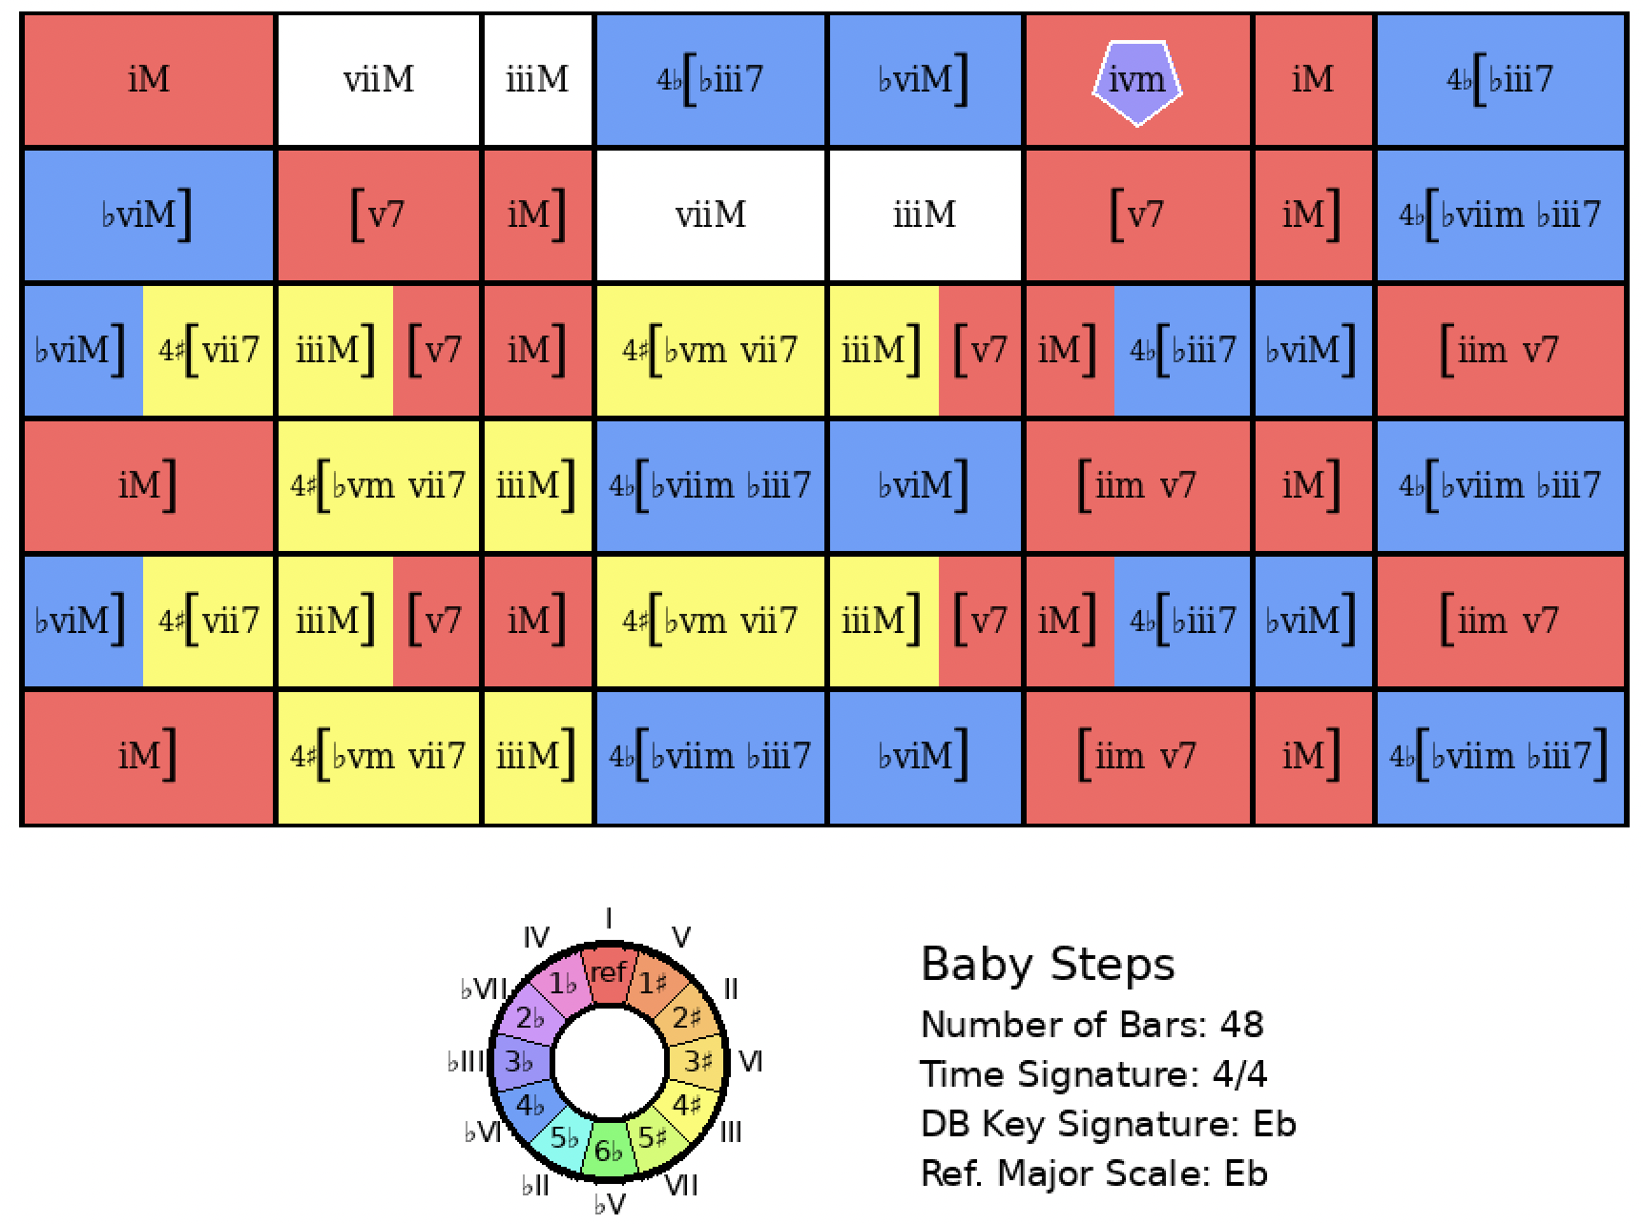
Giant Steps
Rank = 1, Area = 18.47

Slide 13
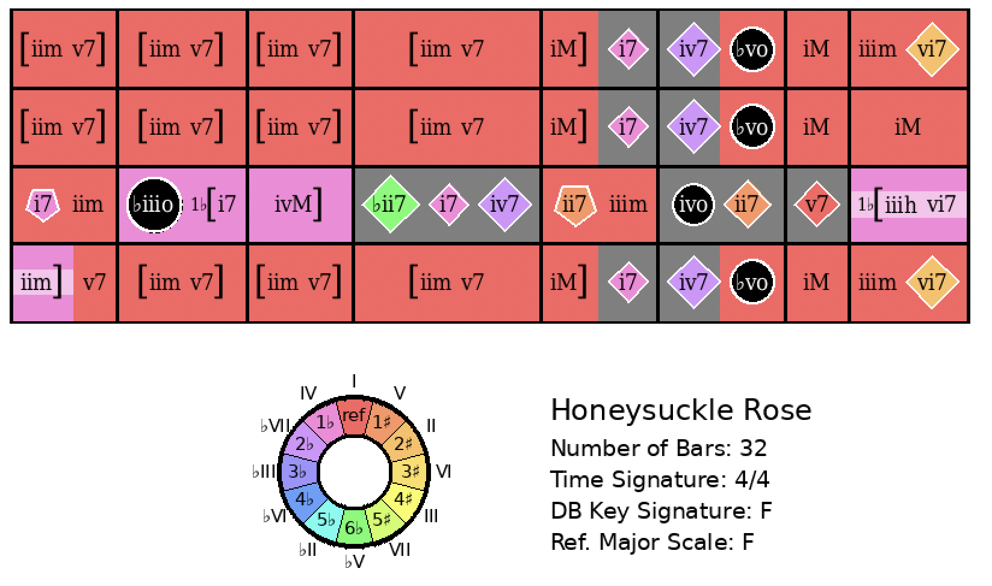
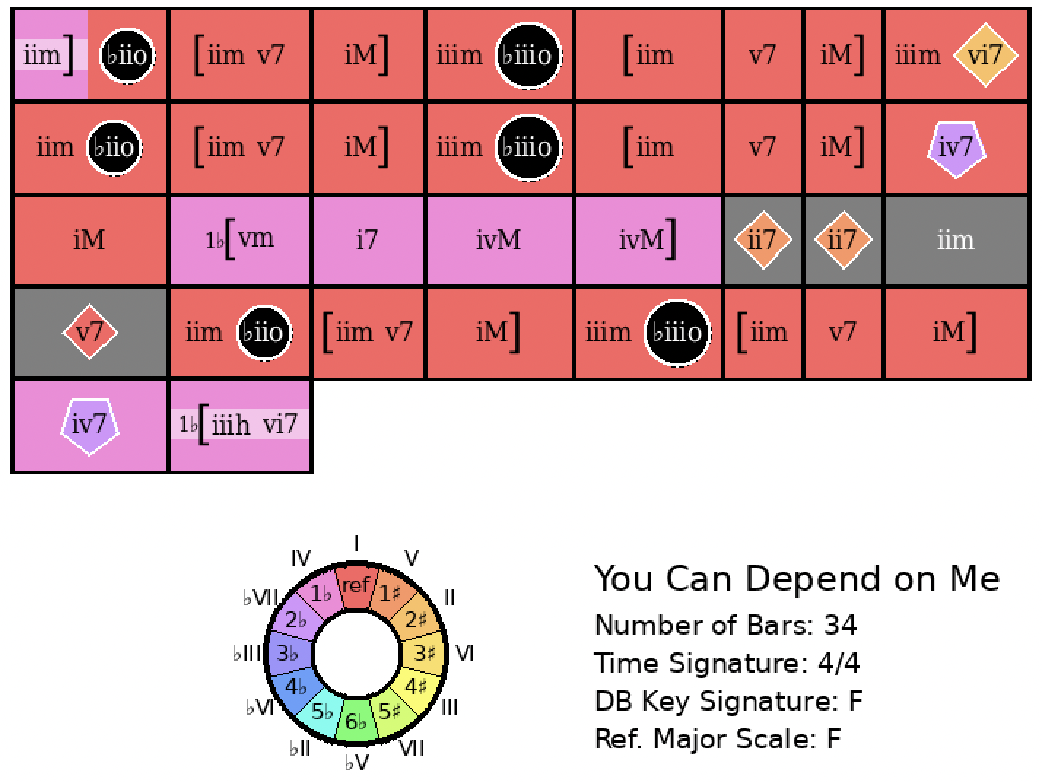
Honeysuckle Rose
Rank = 1, Area = 10.38

Slide 14
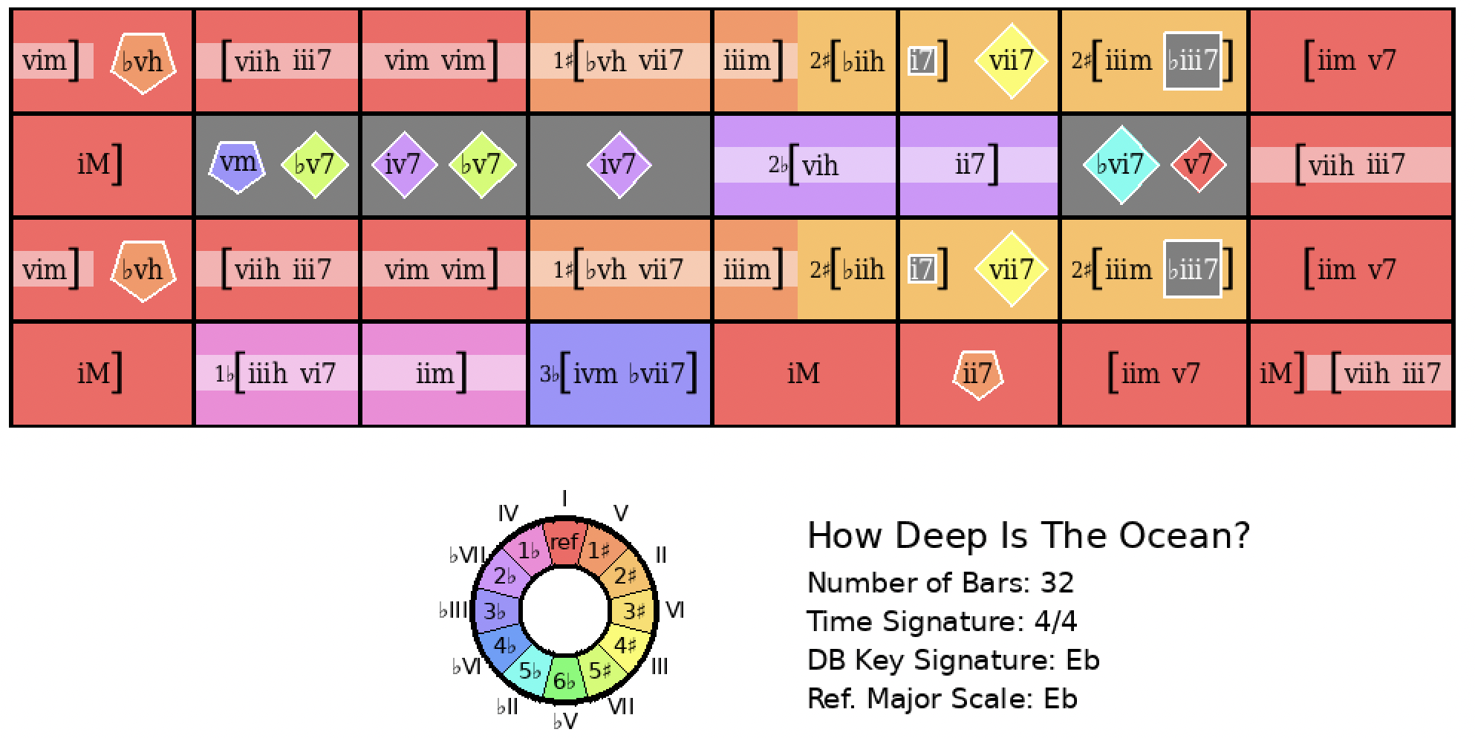
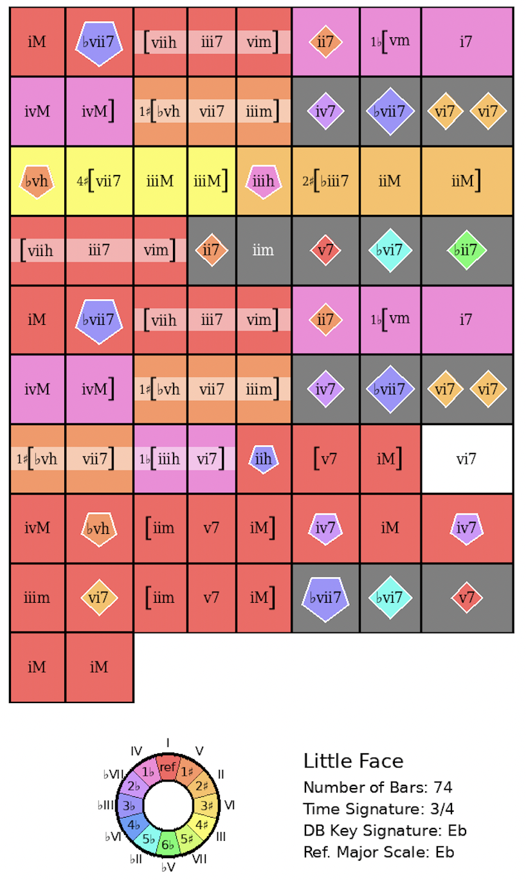
How Deep Is The Ocean?
Rank = 1, Area = 20.42

Slide 15
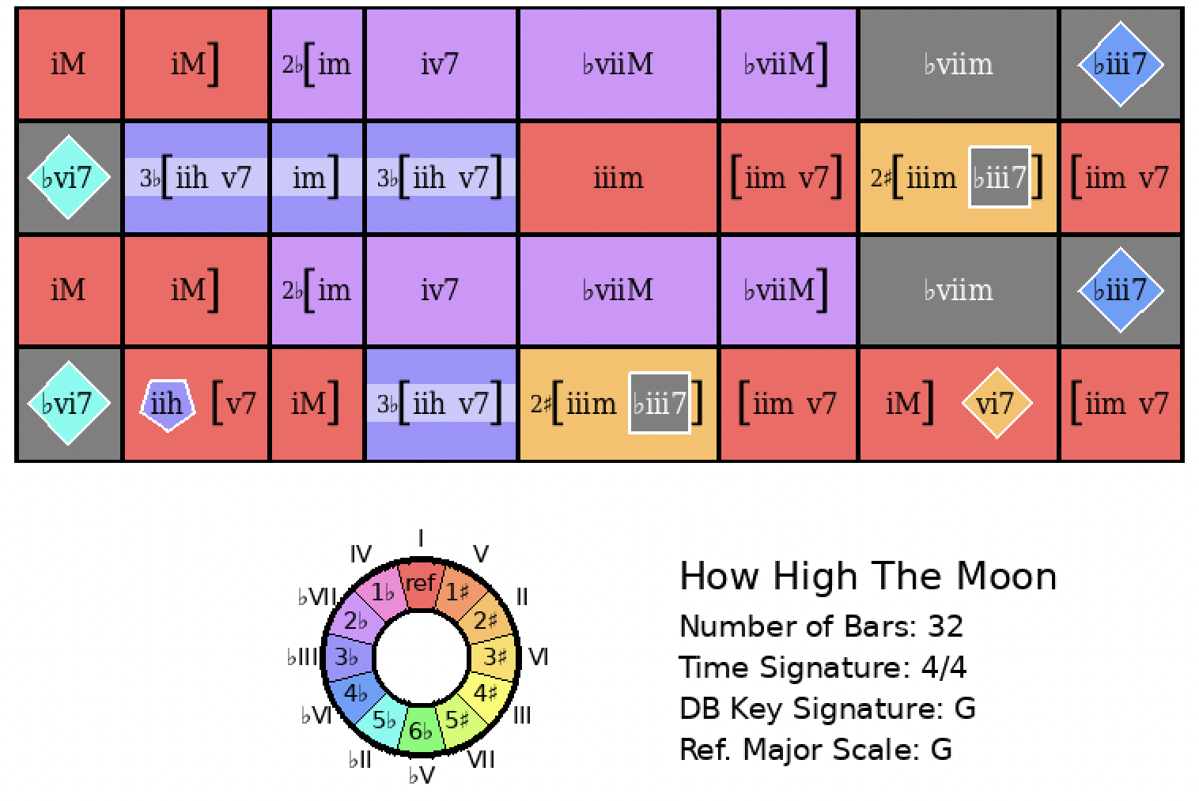
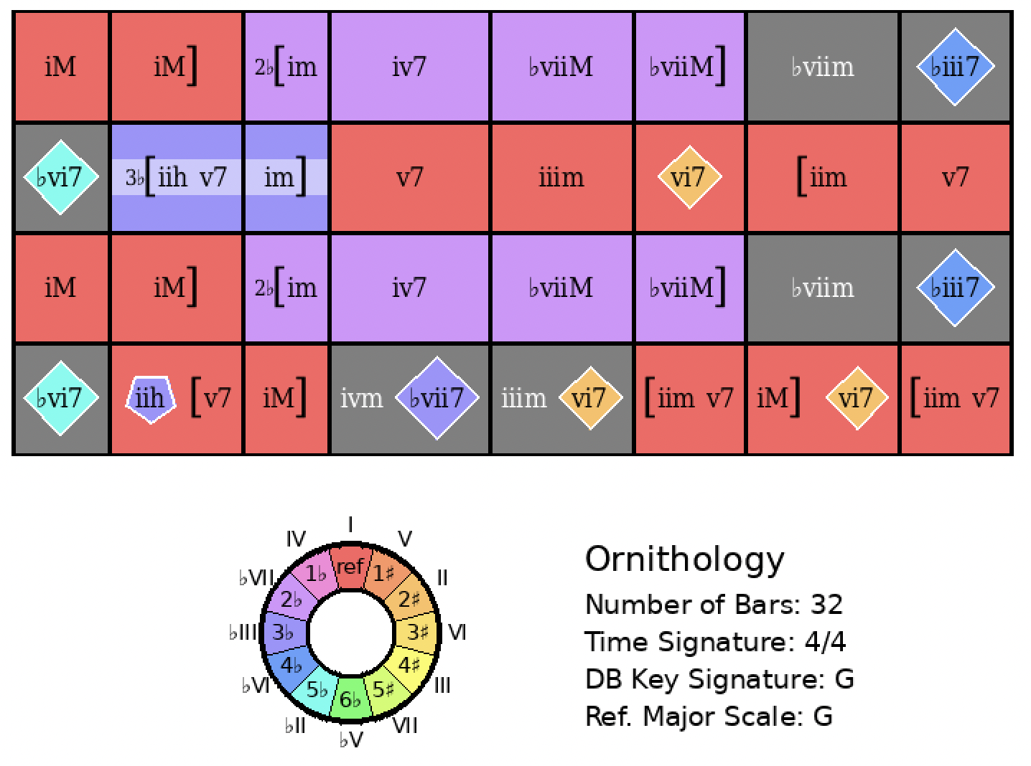
How High the Moon
Rank = 1, Area = 11.55

Slide 16
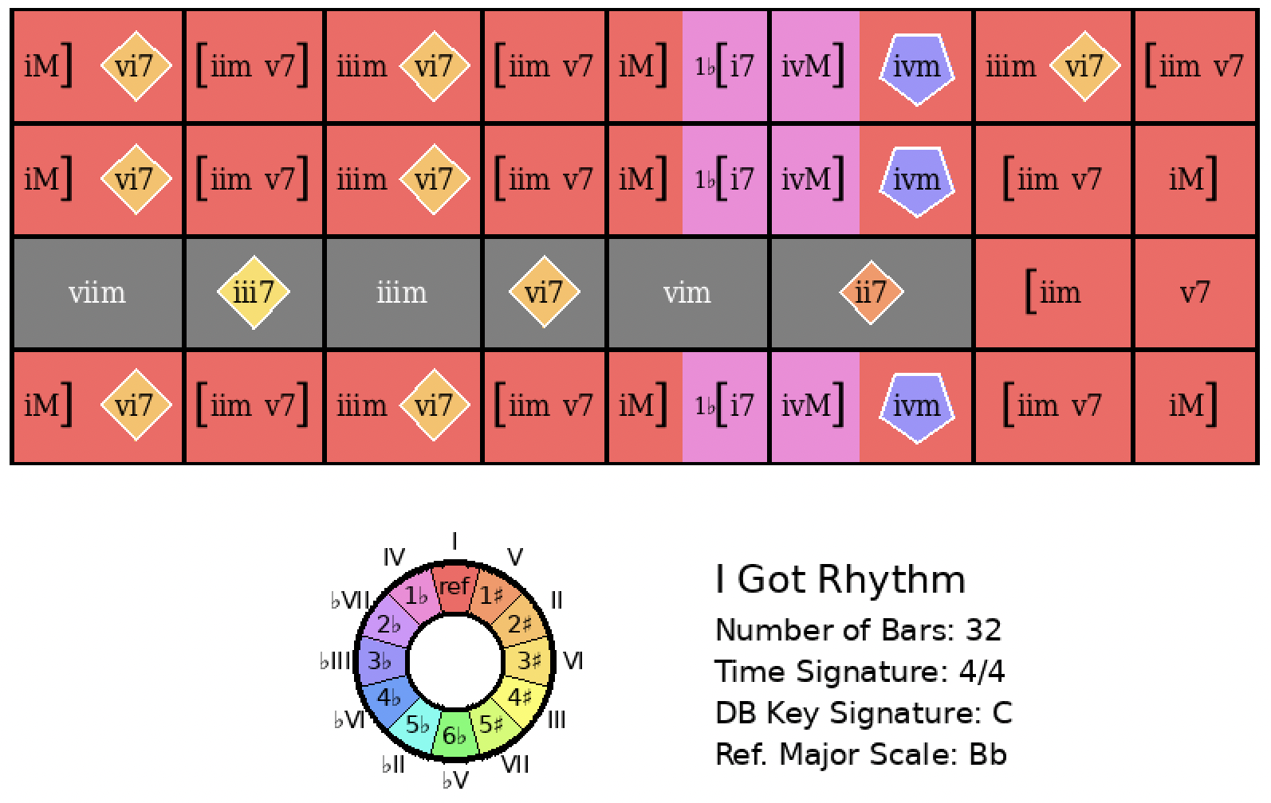
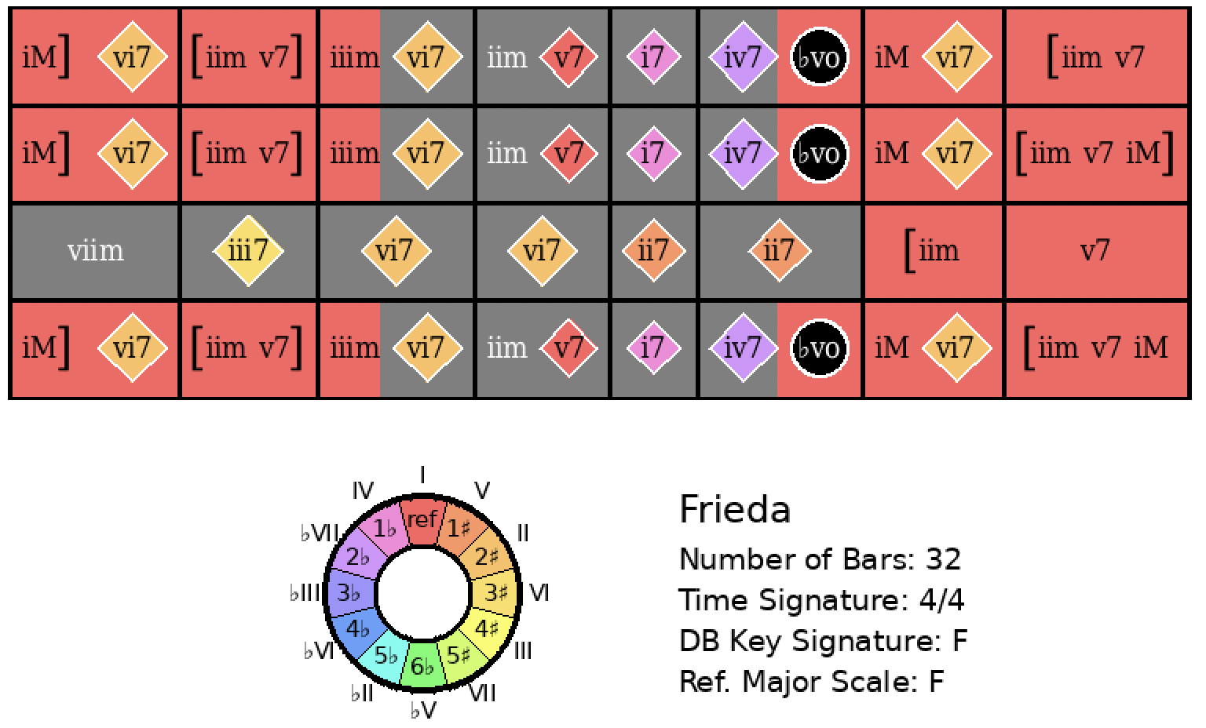
I Got Rhythm
Rank = 1, Area = 8.36

Slide 17
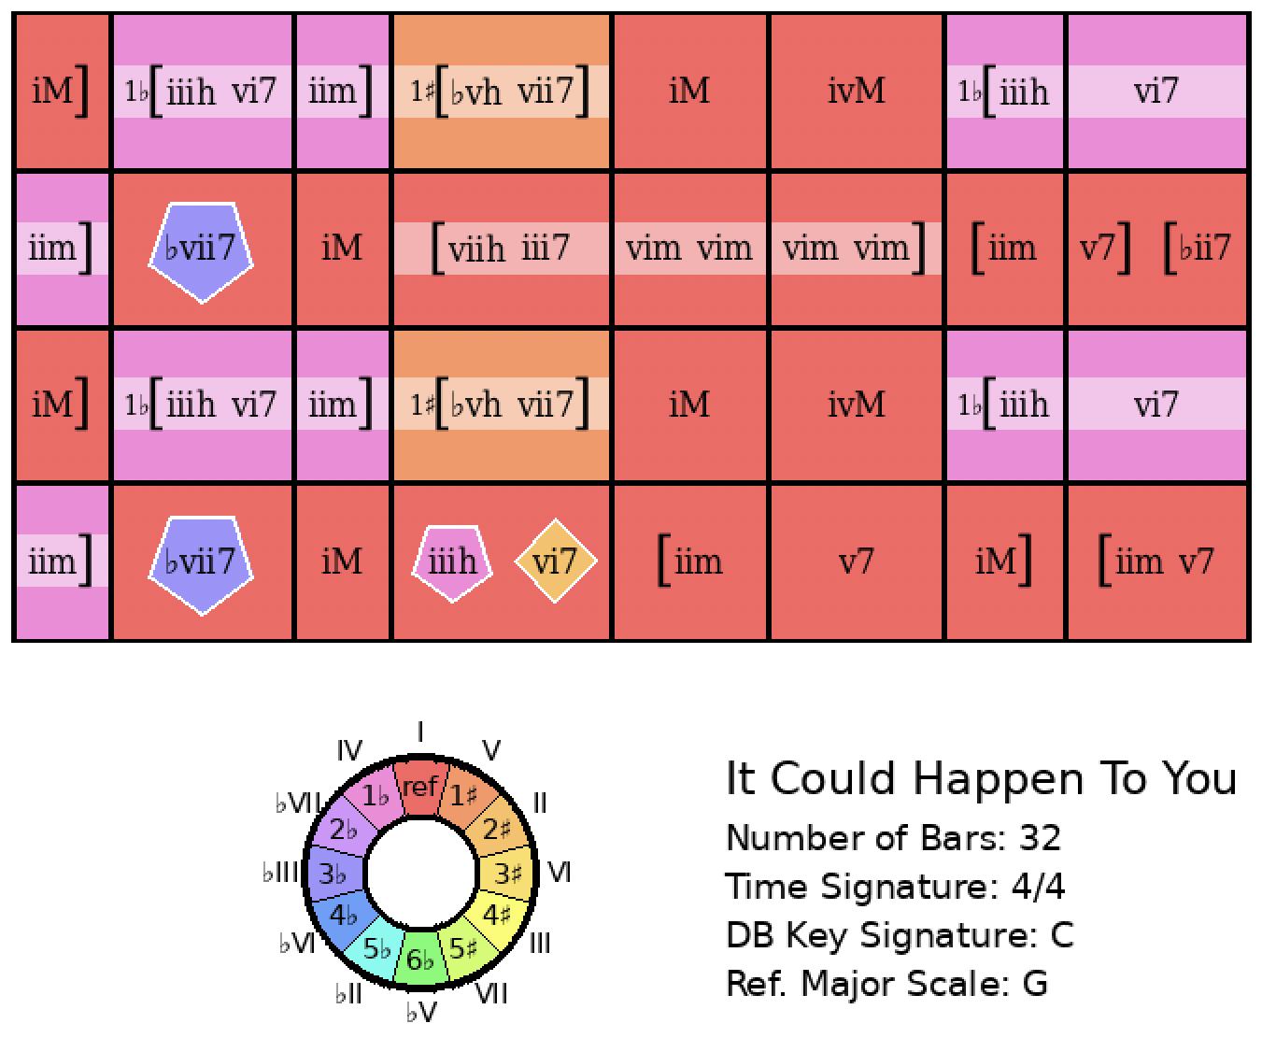
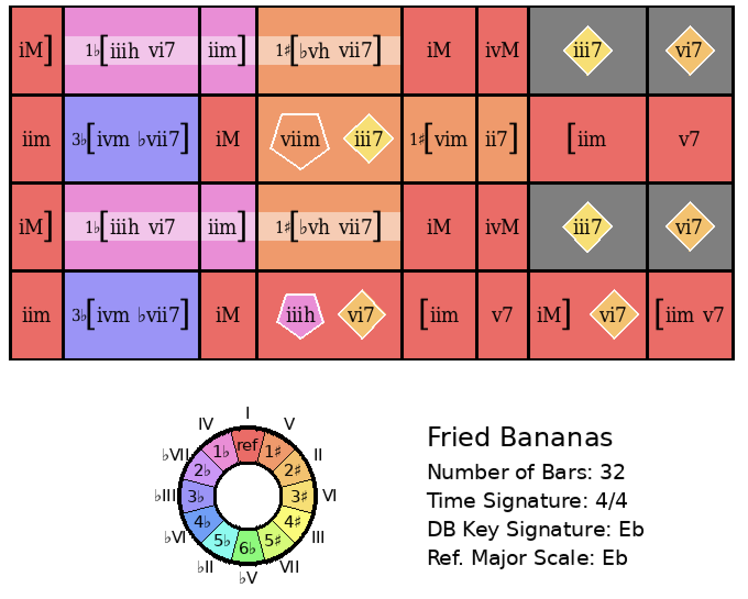
It Could Happen to You
Rank = 1, Area = 9.86

Slide 18
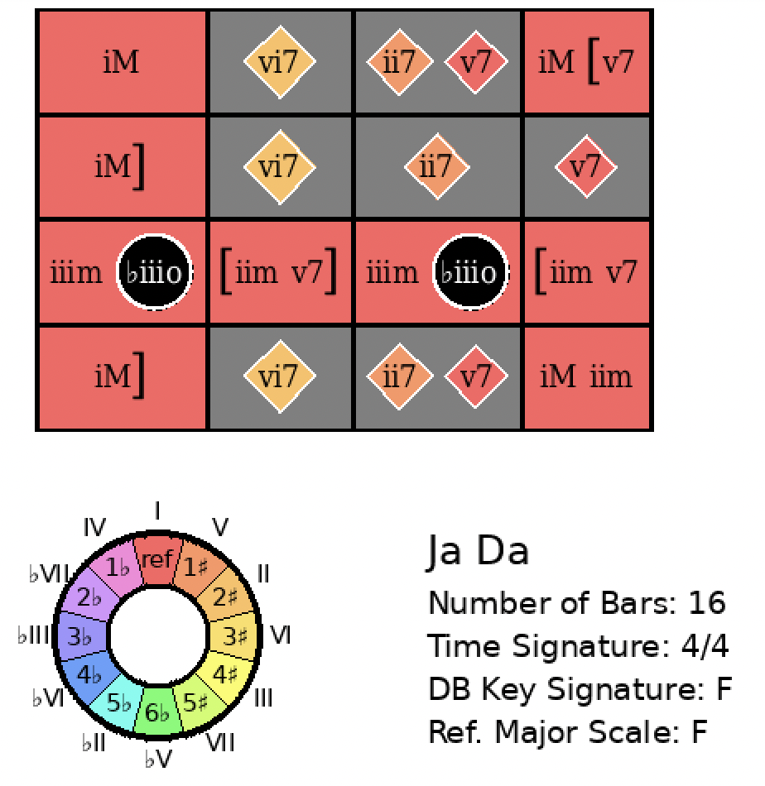
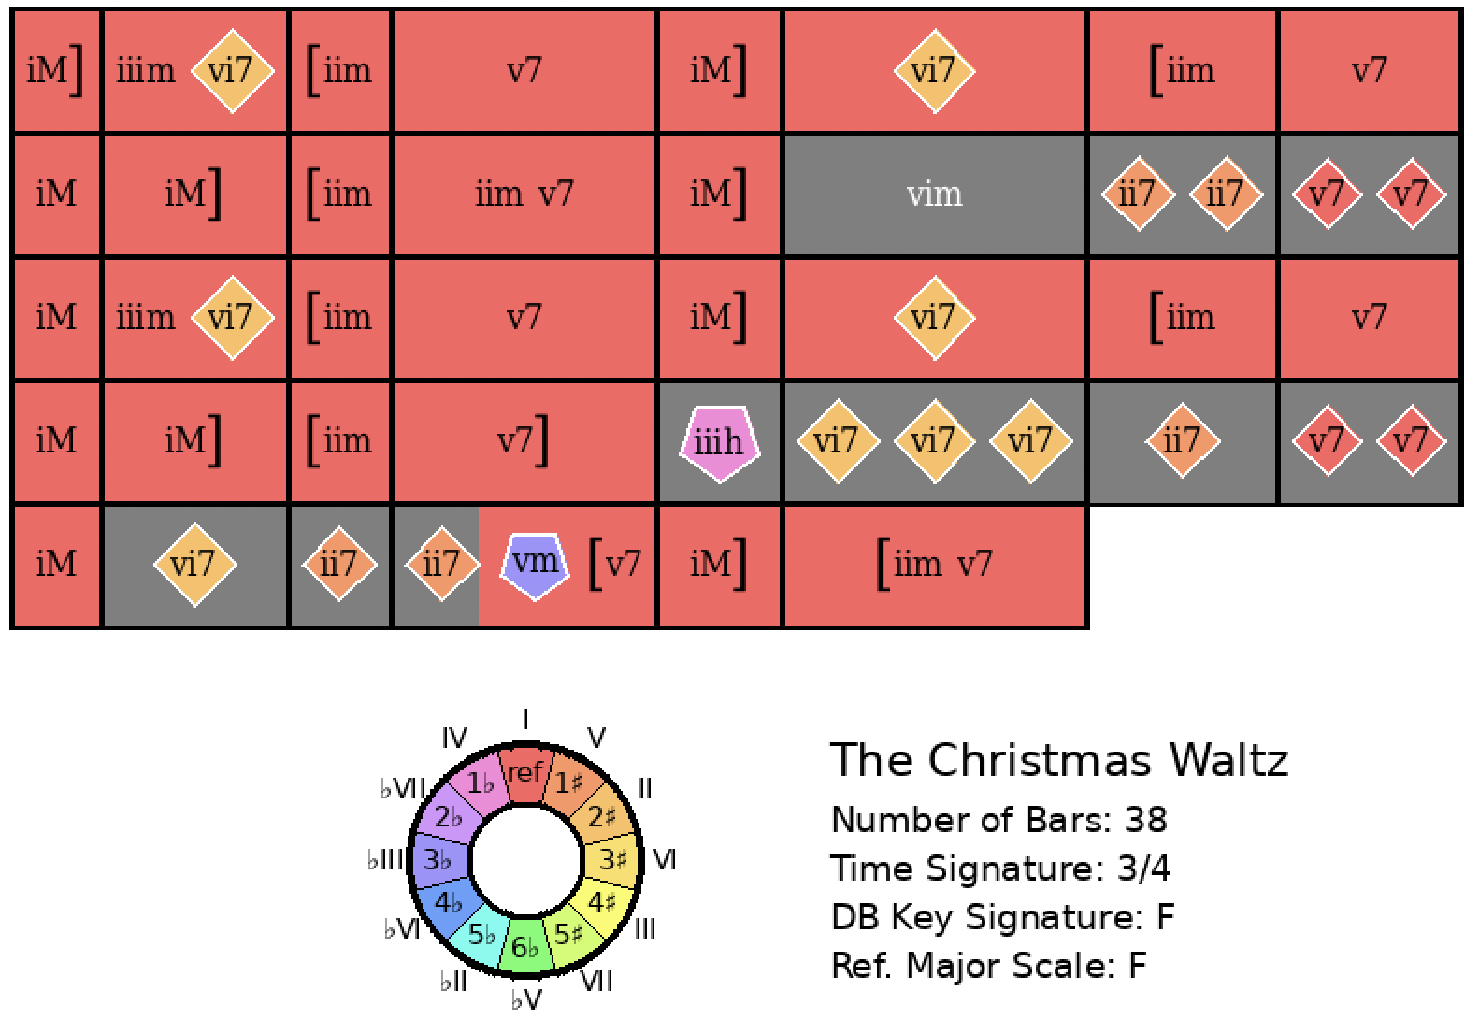
Ja Da
Rank = 1, Area = 11.91

Slide 19
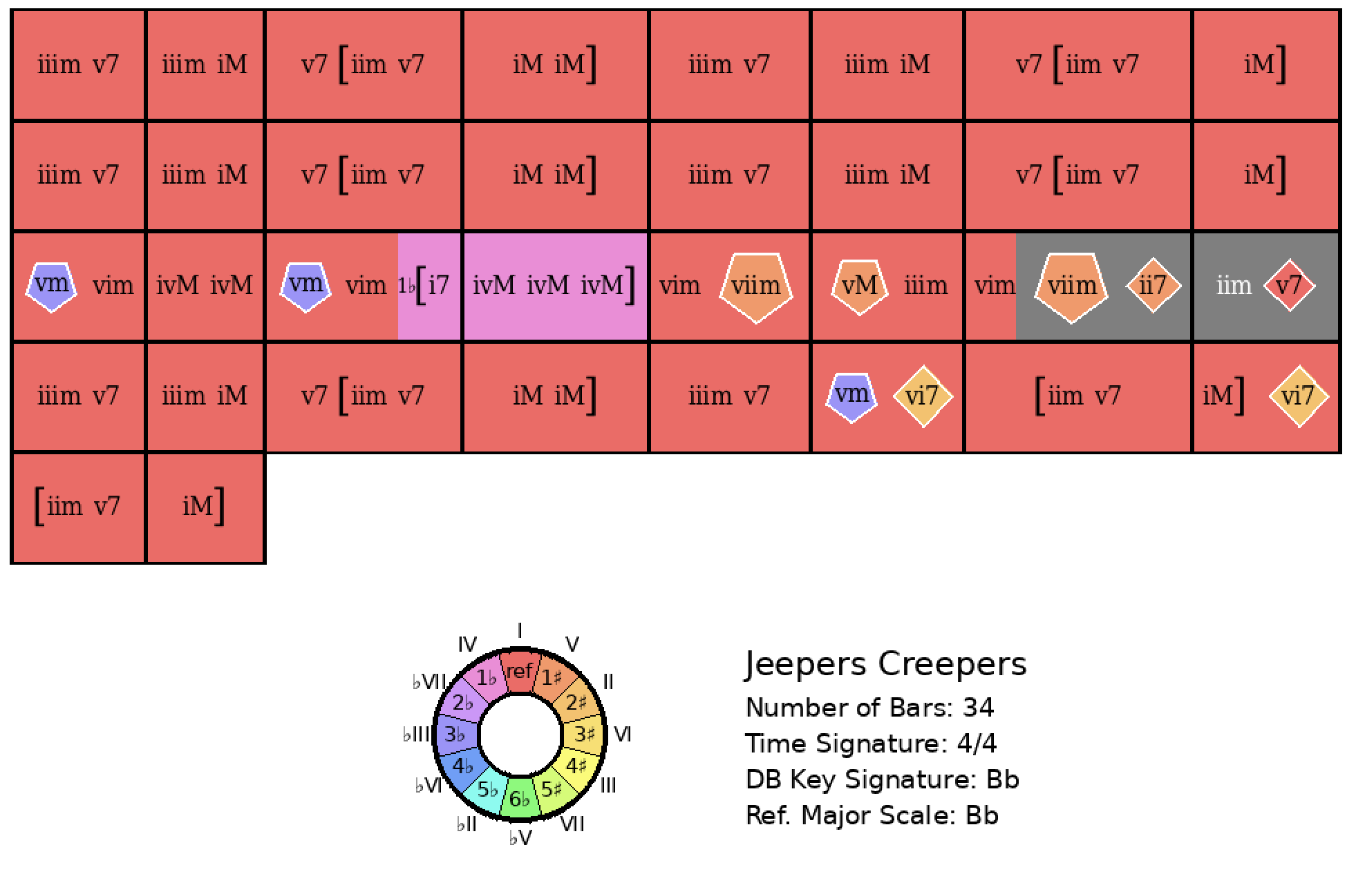
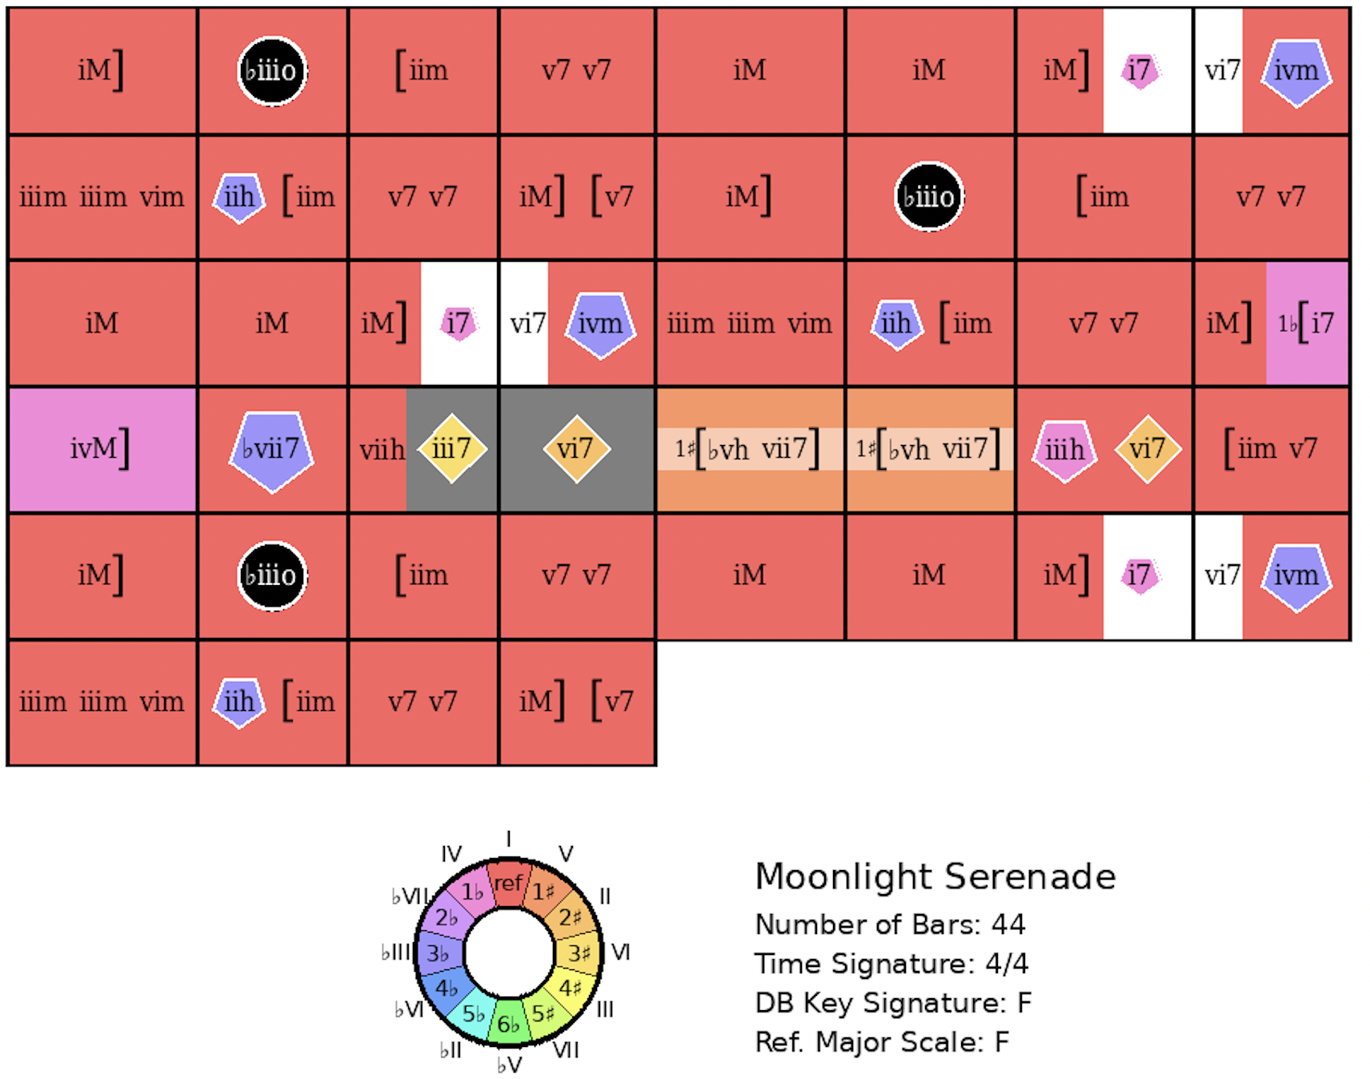
Jeepers Creepers
Rank = 1, Area = 13.82

Slide 20
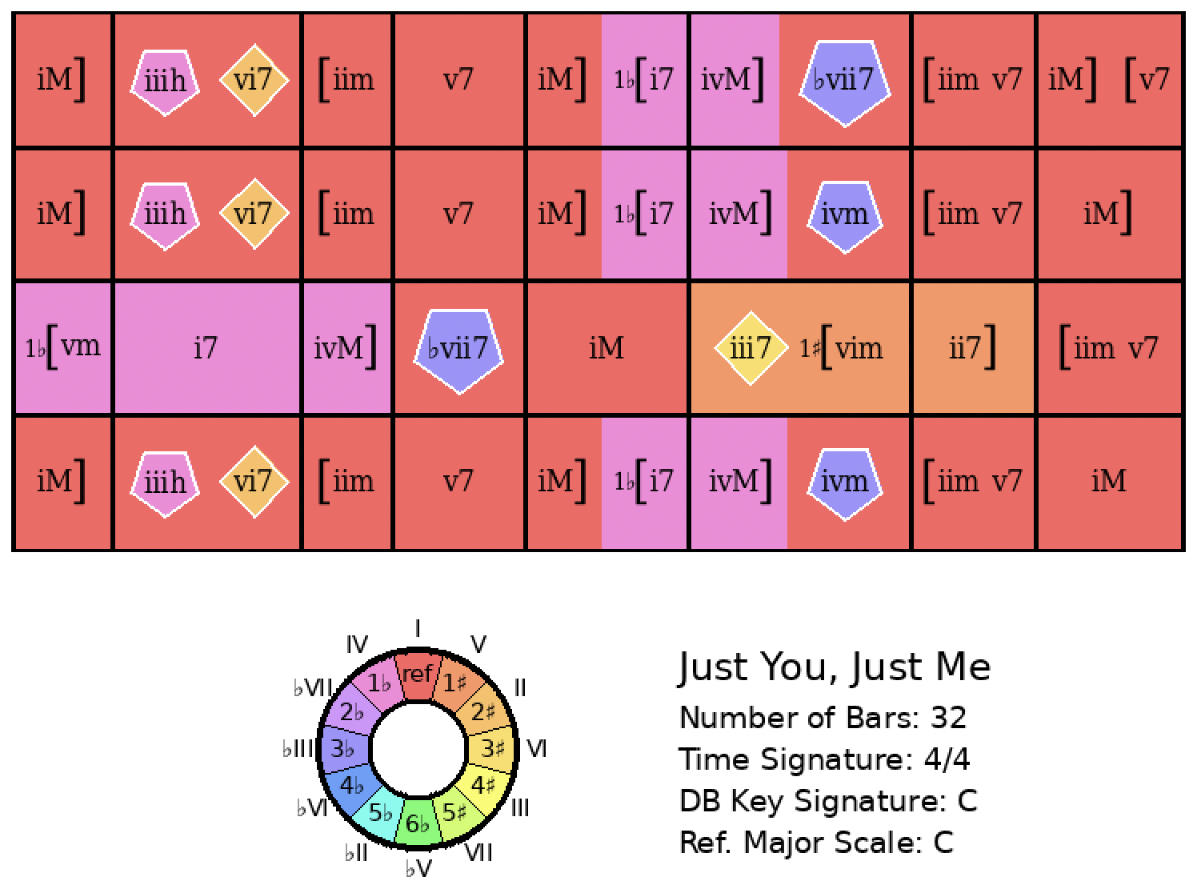
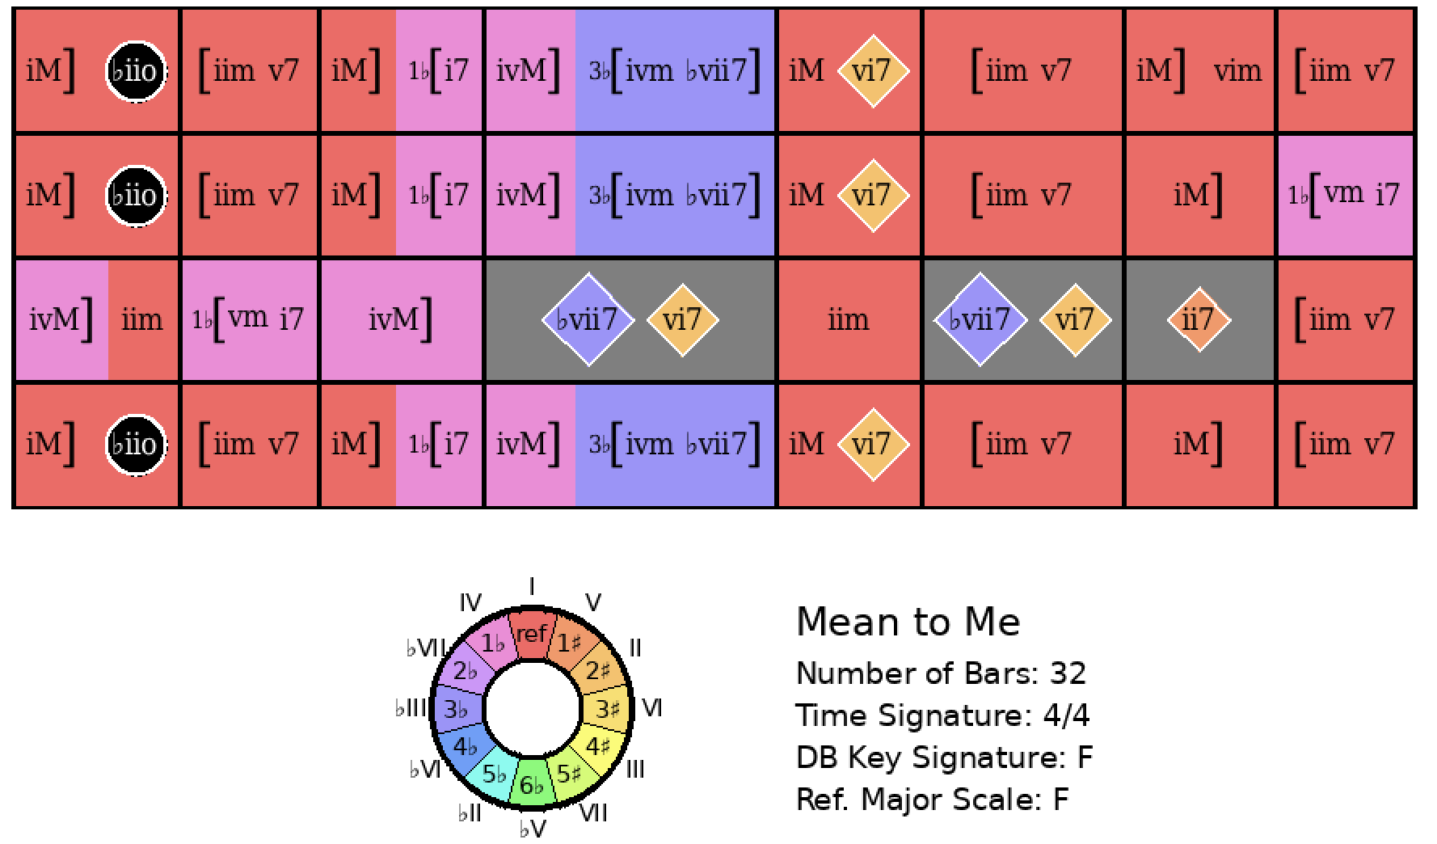
Just You, Just Me
Rank = 1 Area = 10.04

Slide 21
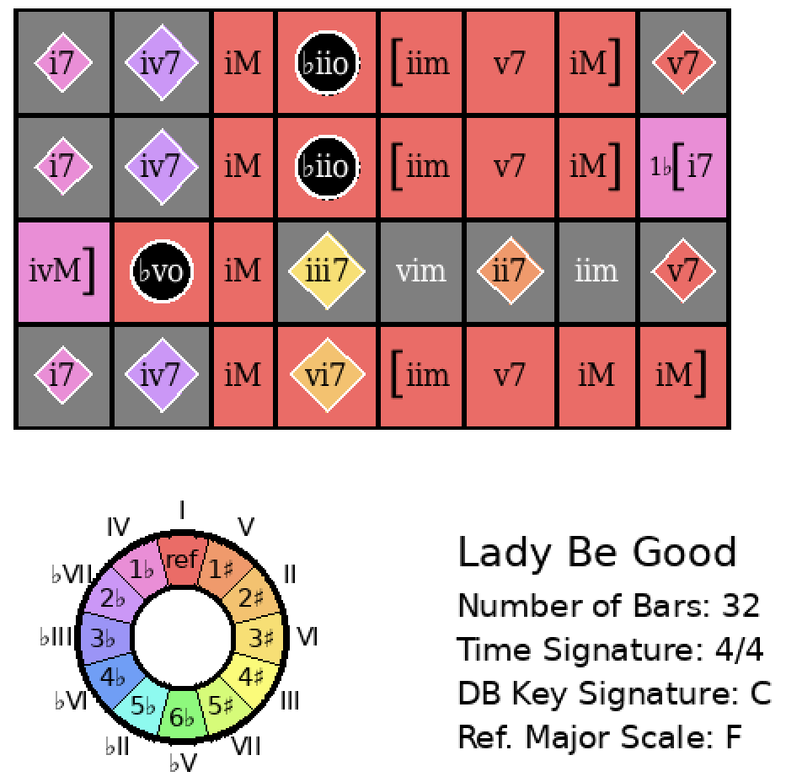
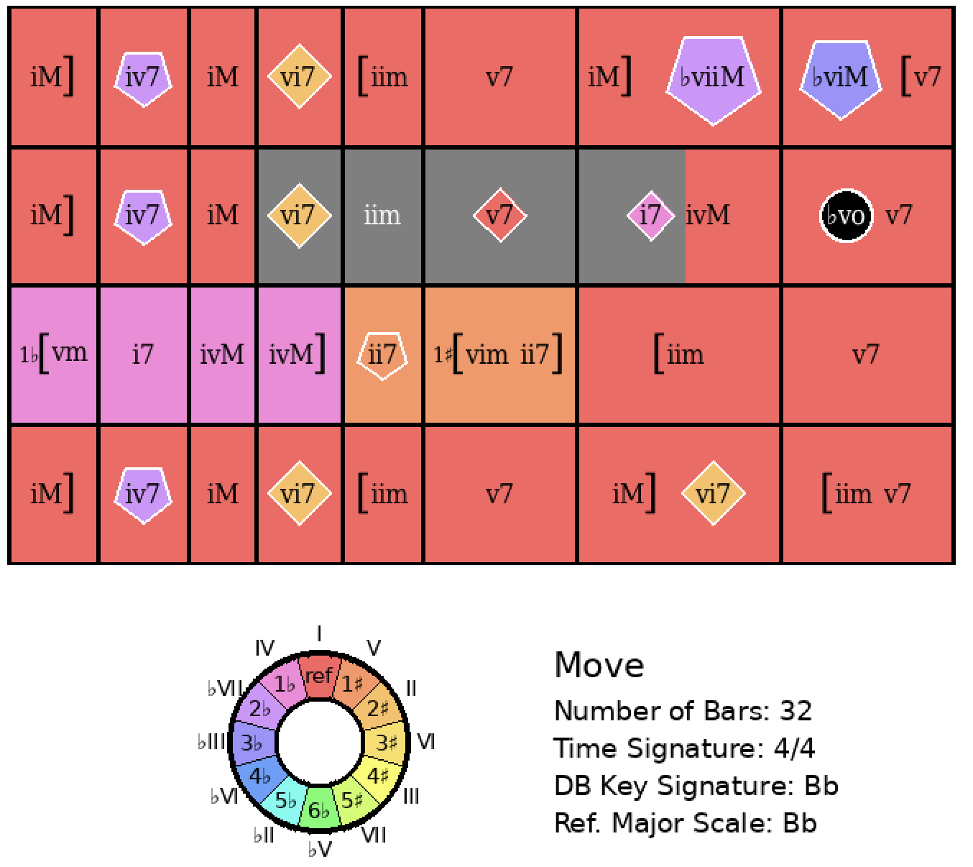
Lady Be Good
Rank = 1, Area = 14.78

Slide 22
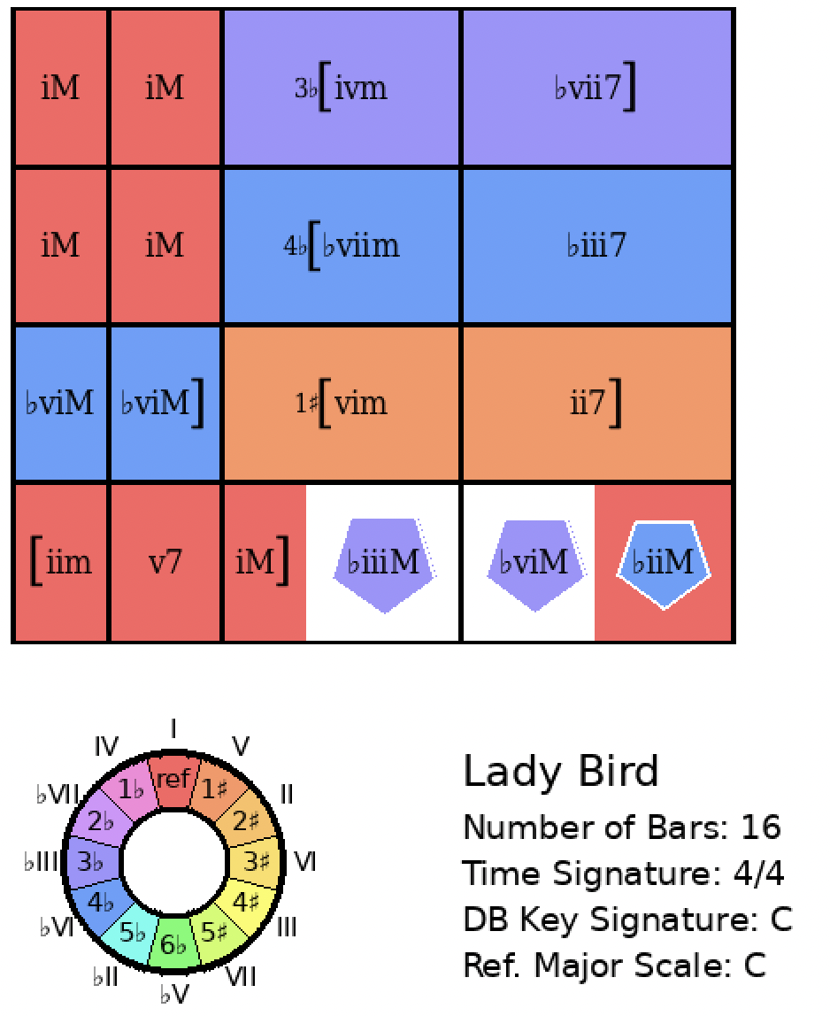
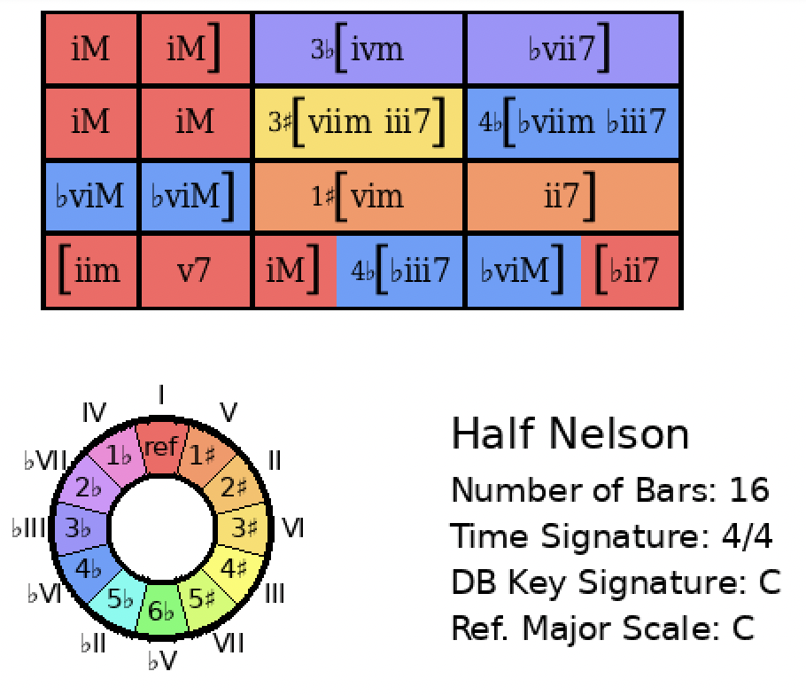
Lady Bird
Rank = 1, Area = 9.68

Slide 23
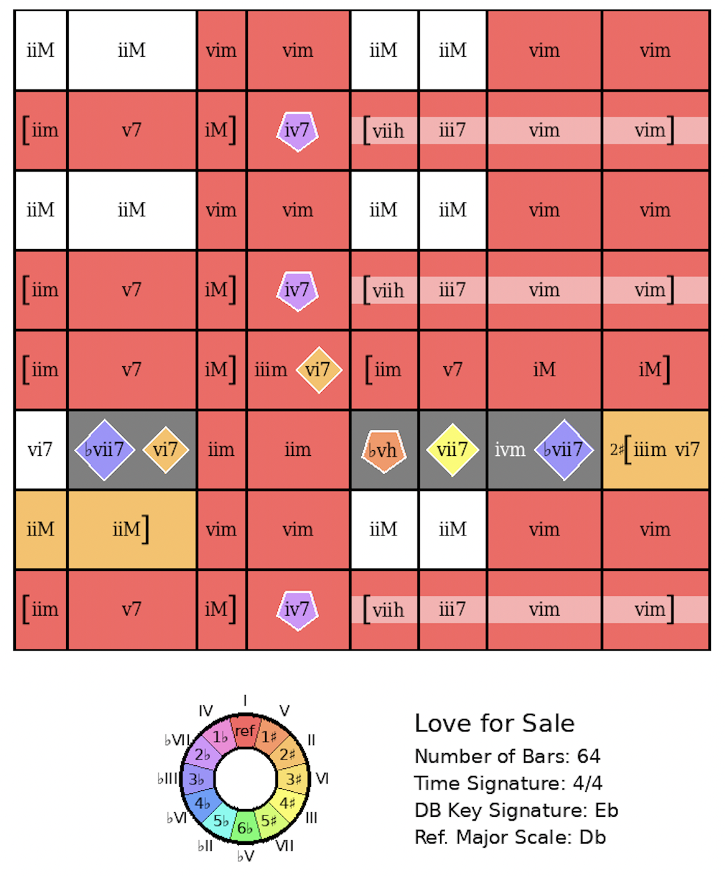
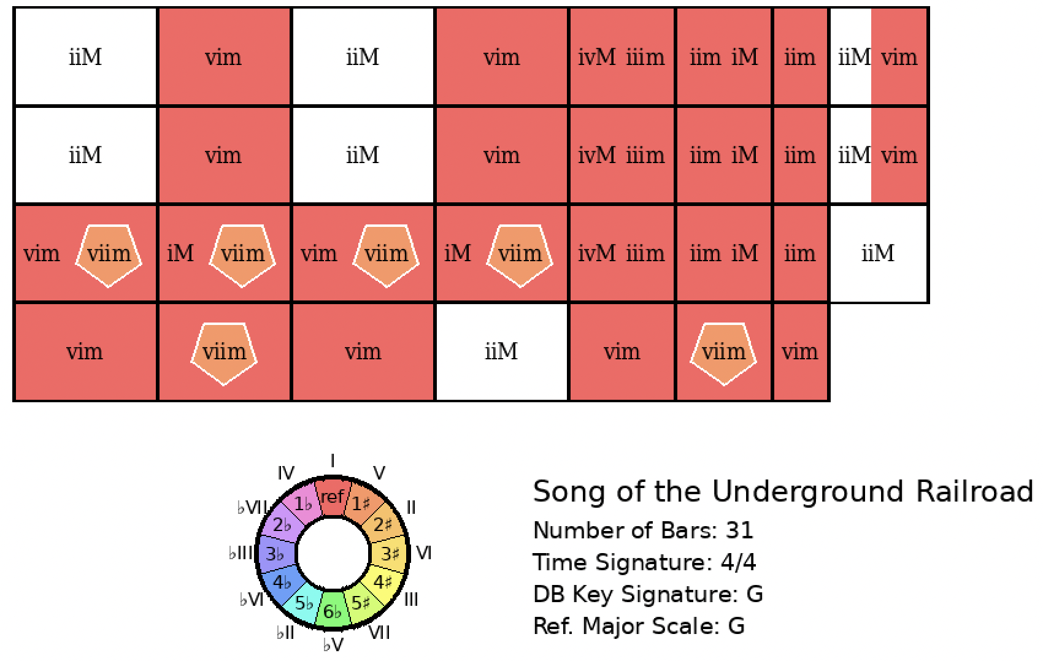
Love For Sale
Rank = 1, Area = 16.18

Slide 24
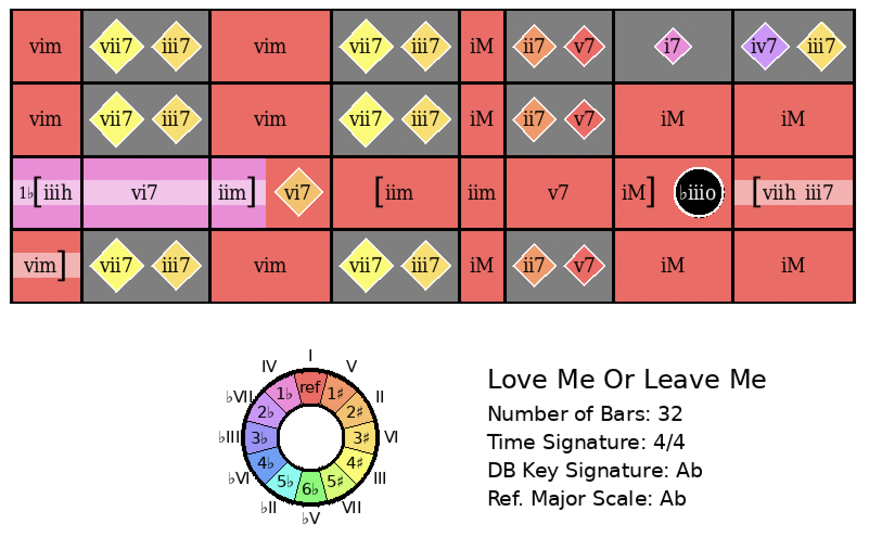
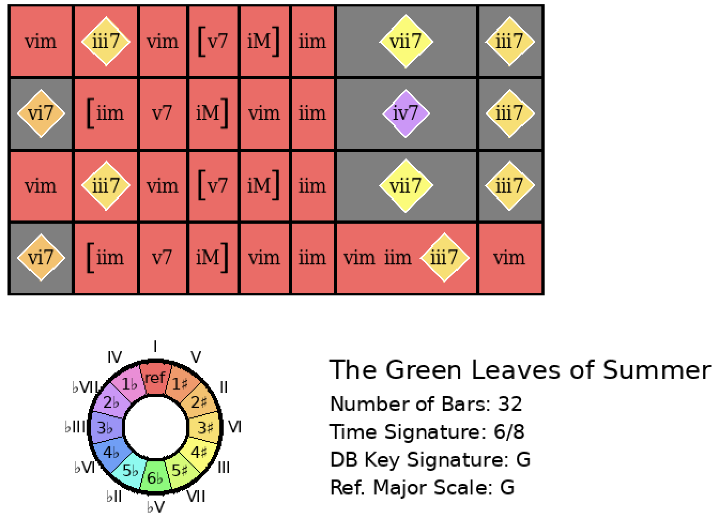
Love Me or Leave Me
Rank = 1, Area = 16.85

Slide 25
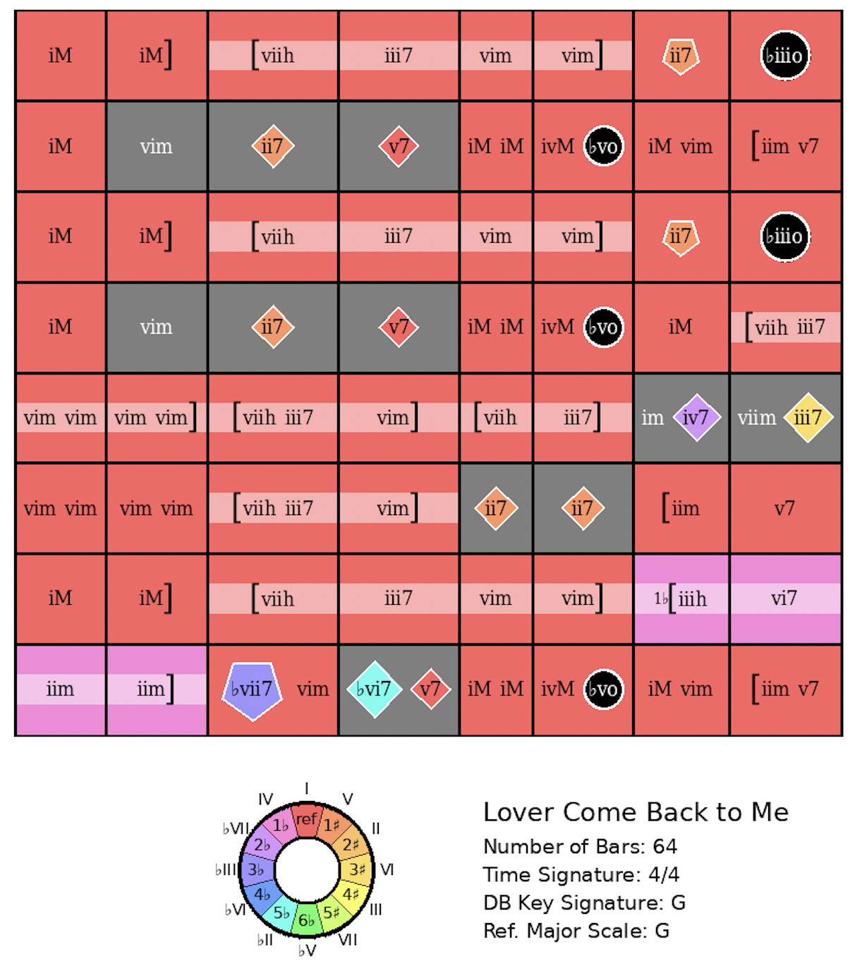
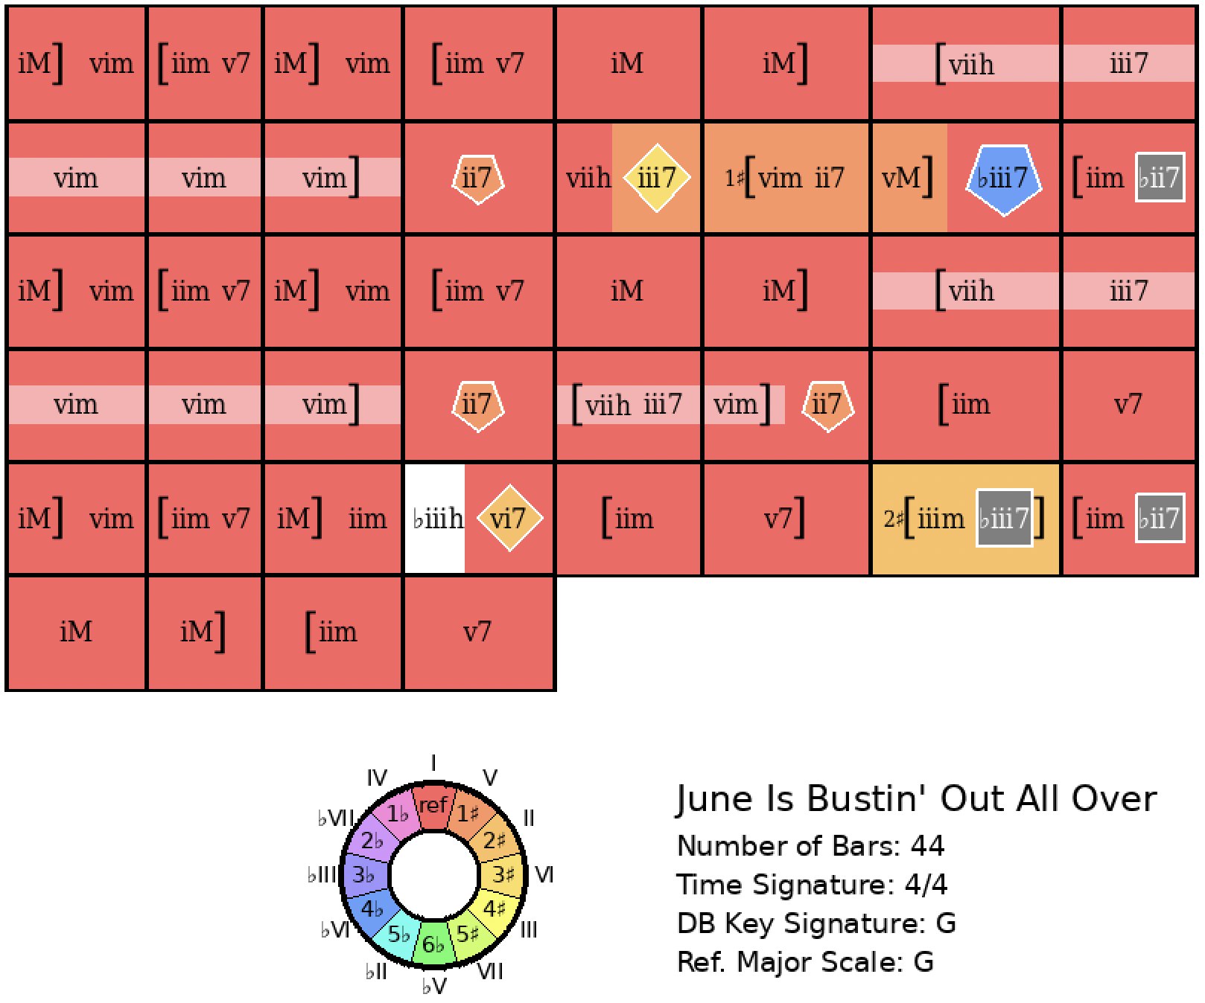
Lover Come Back to Me
Rank = 1, Area = 12.60

Slide 26
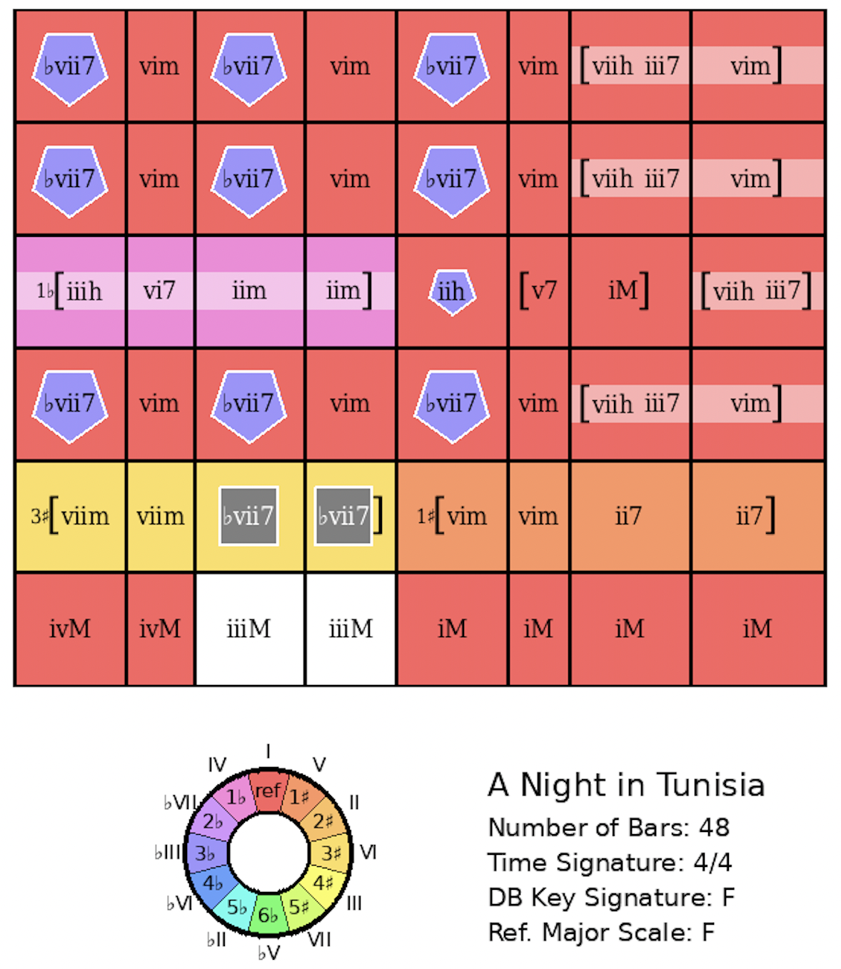
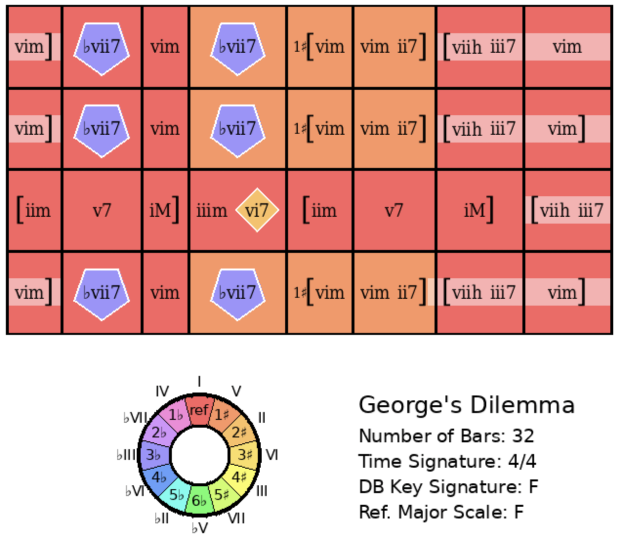
A Night in Tunisia
Rank = 1, Area = 17.68

Slide 27


On Green Dolphin Street
Rank = 1, Area = 13.72

Slide 28


Out of Nowhere
Rank = 1, Area = 16.14

Slide 29


Pennies From Heaven
Rank = 1, Area = 10.18

Slide 30


Rose Room
Rank = 1, Area = 10.89

Slide 31


Rosetta
Rank = 1, Area = 16.16

Slide 32


September in the Rain
Rank = 1, Area = 11.77

Slide 33


So What
Rank = 1, Area = 0.00

Slide 34


The Song Is You
Rank = 1, Area = 15.92

Slide 35


Summertime
Rank = 1, Area = 13.61

Slide 36


Sweet Georgia Brown
Rank = 1, Area = 5.61

Slide 37


Tenderly
Rank = 1, Area = 12.95

Slide 38


Tune Up
Rank = 1, Area = 17.18

Slide 39


Twilight Time
Rank = 1, Area = 13.15

Slide 40


What Is This Thing Called Love?
Rank = 1, Area = 0.00

Slide 41


Whispering
Rank = 1, Area = 12.95

Slide 42


You Can Depend On Me
Rank = 1, Area = 5.82

